Slide 1

Town of Brentwood Council Update
June 20, 2023
Contact: cm3@brentwoodmd.gov

Slide 2

Sustainable Brentwood Green Team Tree Committee

Slide 3
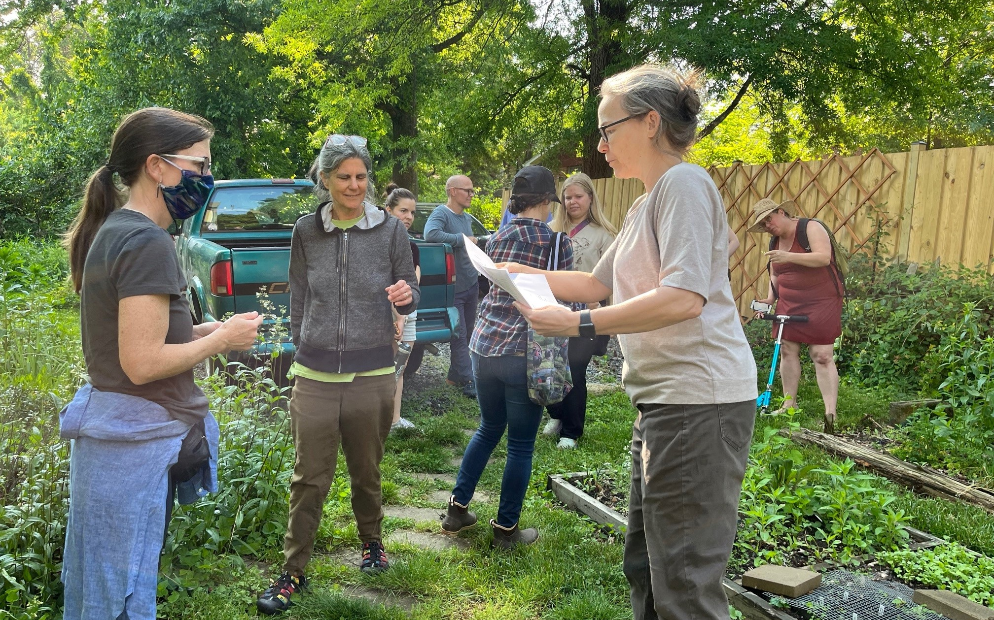
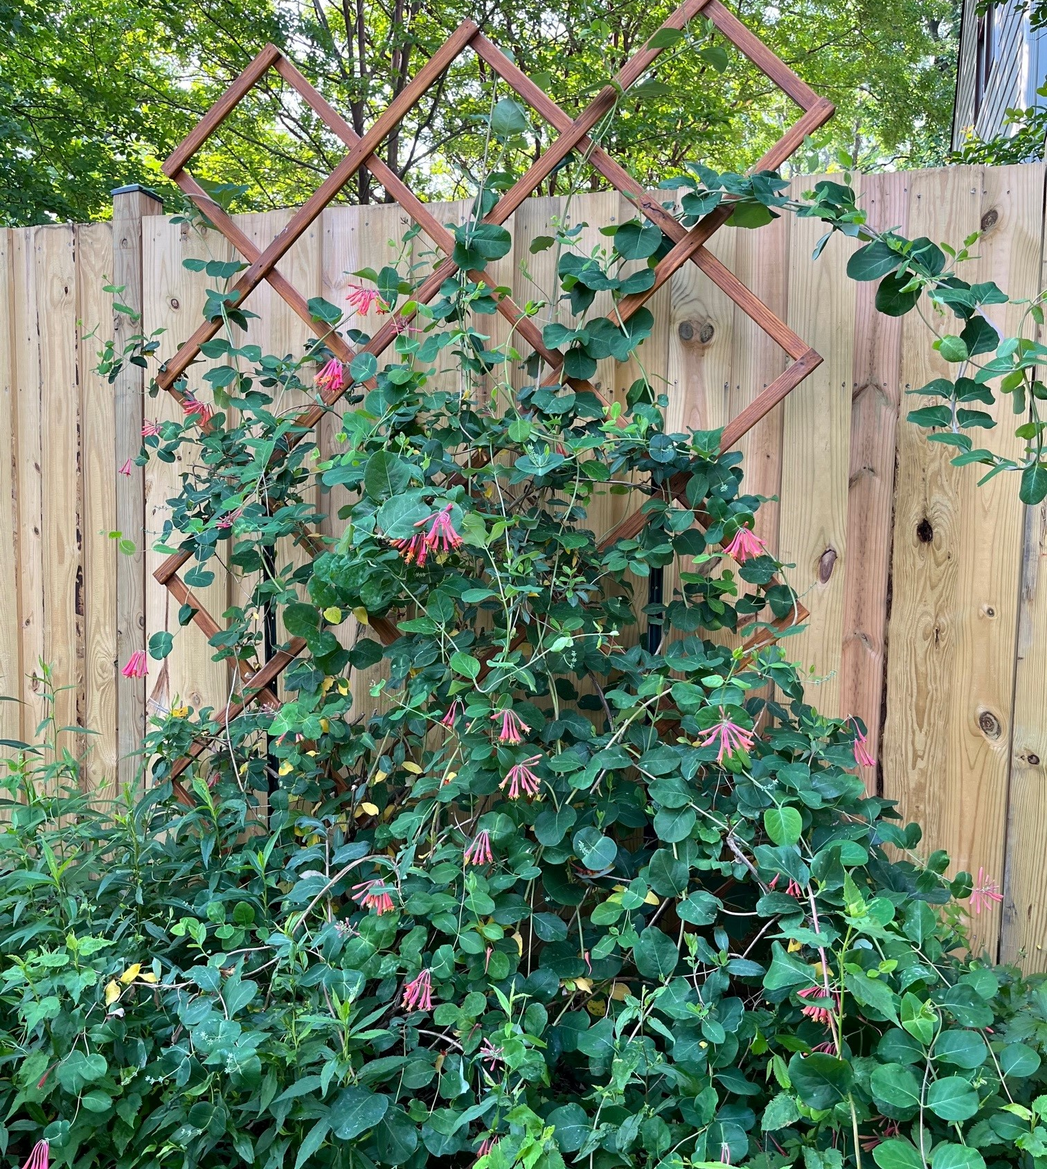
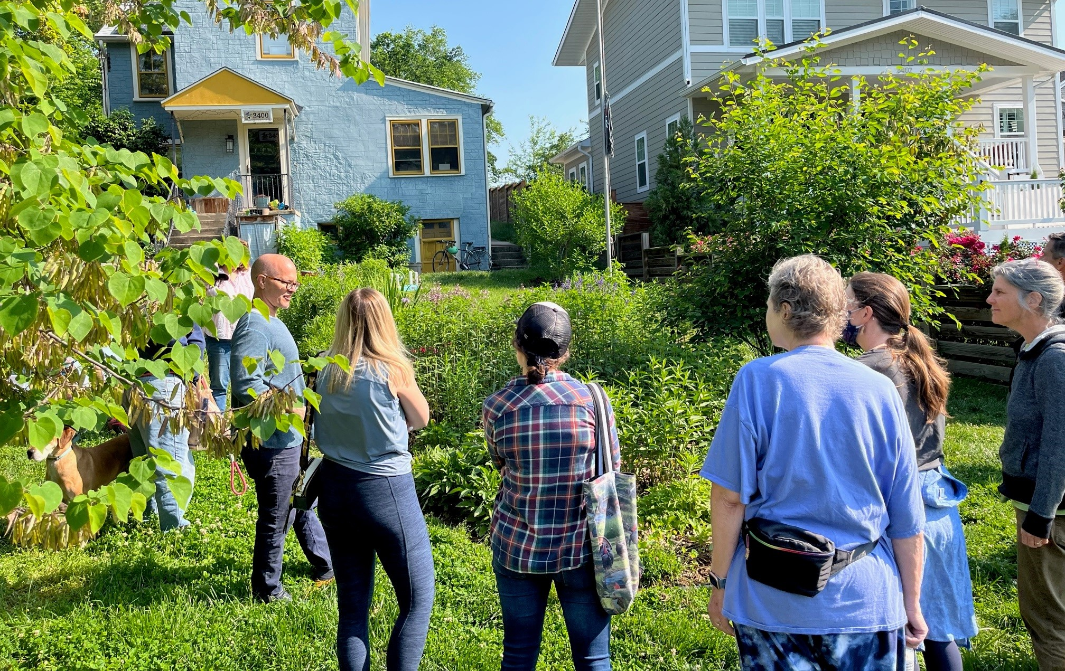
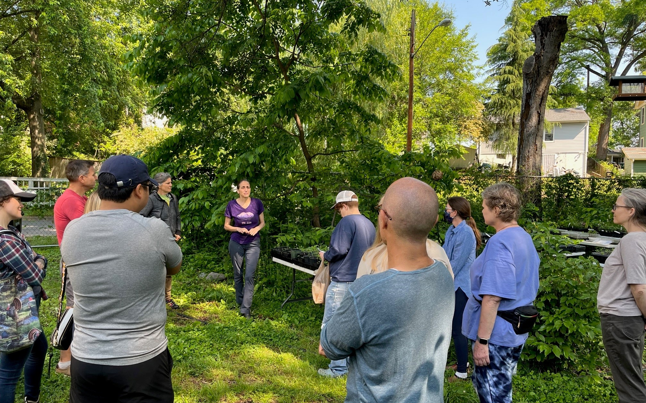
Brentwood Native Plant Garden Tour
Residents from Brentwood, Mt Rainier and Cottage City toured the park at Upshur & 34th Street and a few homeowner gardens and learned about:
Turning a yard from grass to native garden
Butterfly host plants
What’s that plant really look like and do?

Slide 4
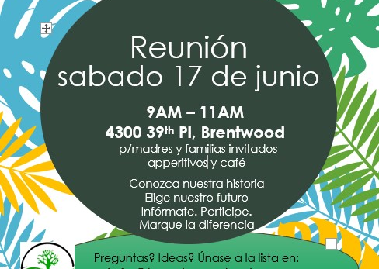
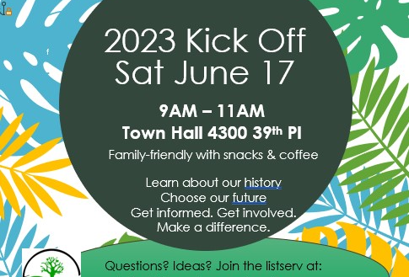
Events
6/3 Brentwood Day
The Sustainable Brentwood Green Team Tree Committee and Brentwood Native Plant Network table with plants from Chesapeake Natives, butterfly outdoor learning, activities for kids and information for families from NIH and Pollinator.org
6/17 at 9AM Sustainable Brentwood Green Team Tree Committee community gathering
Meet at Town Hall 4300 39th Place
Family-friendly with snacks & coffee
Learn about our proud heritage of environmental action
Choose our future actions
July & August gatherings TBD for Sustainable Brentwood Green Team Tree Committee
cm3@brentwoodmd.gov

Slide 5
Community Building & Discussion
Interests
Climate resiliency, Bartlett park, splashpad improvement
Involvement, rain barrels, trees, permaculture
Native plants, electrification, bike infrastructure
Bettering Rhode Island Ave for transit and biking, bike infrastructure, recreational connectivity, gardening
Native plants, environmental education, recycling education, climate resiliency and heat islands
Green Team, clean-ups, tree projects, municipal energy efficiency
Science, education, climate change, plastic management, waterways, local food
E-recycling, recycling education, reducing footprint
Circular economy, plastic industry reduction, trees
Solar energy, litter, recycling education
Questions
How can we make progress?
Can the town support residents with electrification / solar and greenhouse gas reduction?
How do we address the larger problems with regional solutions (county and state)?
How do we go about getting funding and grants?
How do we work together as a community and network?
Can we change the way we work with county and get county services like trash, recycling, compost?
How do we know Bates is really recycling?
What’s our domain as citizen versus Pepco?
Favorite Nature Place/Thing
Bike trail
River trail
Bike trail
Park
Run/bike trail
Walk to nature
Walking trail
Resident backyard
The Bay

Slide 6
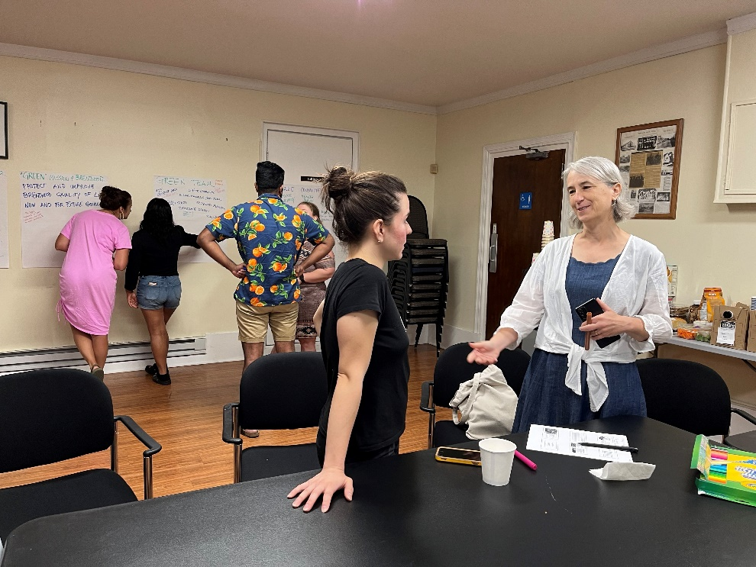
“Green” Vision for Brentwood
We all brainstormed and shared ideas
Eco-resilient
Thriving
Equitable
Solar-powered
Effective transit
Recycling more
No litter
Community composting
More flowers
Effective transit
connect to purple line
Rhode Island buses
Active transportation
Swimmable river
Brentwood not just a “tree city” but a “green city”
Leader in small towns to do innovative projects
Diversity Equity Inclusion: involve whole community centers and owners

Slide 7
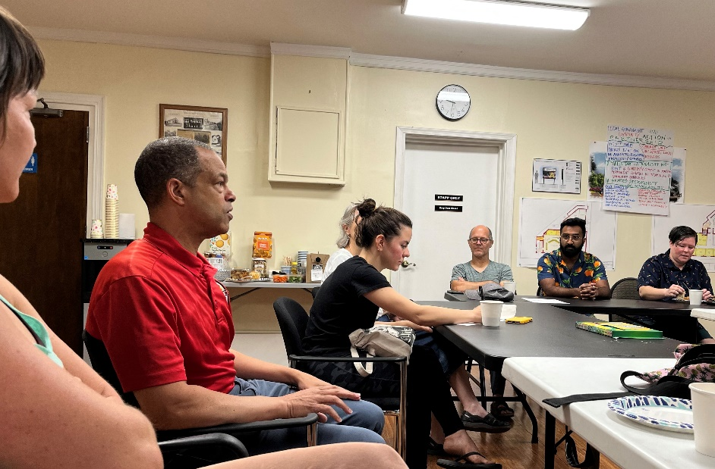
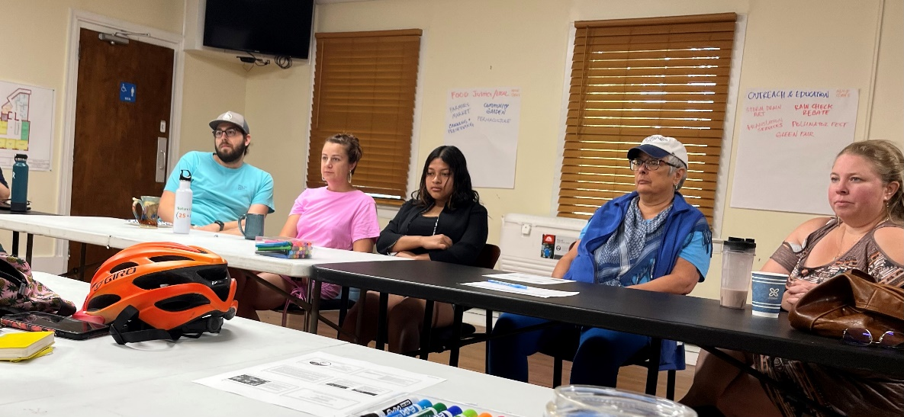
“Green” Mission for Brentwood
We all brainstormed and shared ideas
Protect and improve Brentwood quality of life now and for future generations
Be highly educated in green initiatives that call to action and bring funding
Engage youth on environmental issues
Allow people and nature to co-exist
Be sustainable commercially and residentially
Resilient to natural hazards

Slide 8
“Green” Vision for Brentwood
We all brainstormed and shared ideas
Eco-resilient
Thriving
Equitable
Solar-powered
Effective transit
Recycling more
No litter
Community composting
More flowers
Effective transit
connect to purple line
Rhode Island buses
Active transportation
Swimmable river
Brentwood not just a “tree city” but a “green city”
Leader in small towns to do innovative projects
Diversity Equity Inclusion: involve whole community centers and owners

Slide 9
“Green” Mission for Brentwood
We all brainstormed and shared ideas
Protect and improve Brentwood quality of life now and for future generations
Be highly educated in green initiatives that call to action and bring funding
Engage youth on environmental issues
Allow people and nature to co-exist
Be sustainable commercially and residentially
Resilient to natural hazards

Slide 10
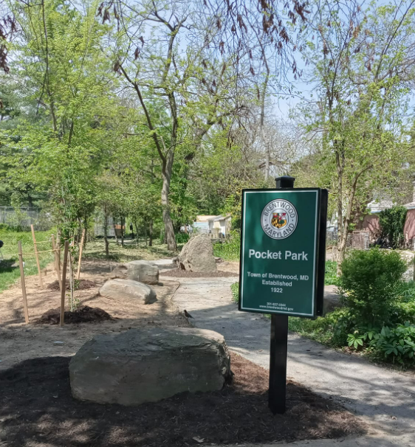
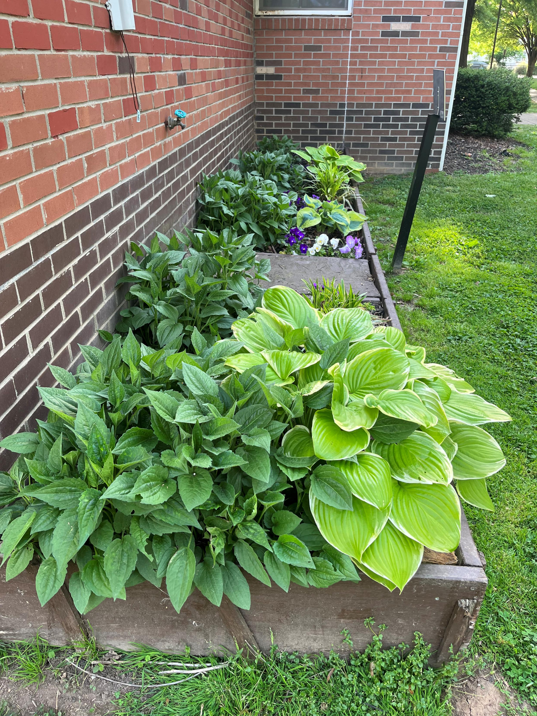
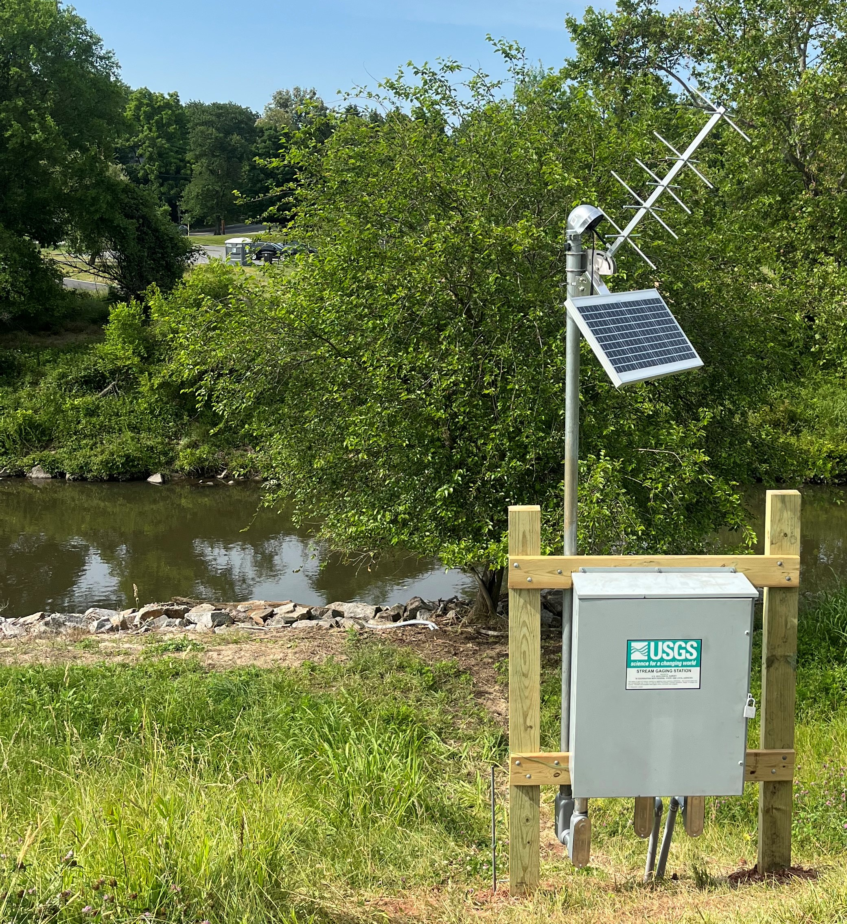
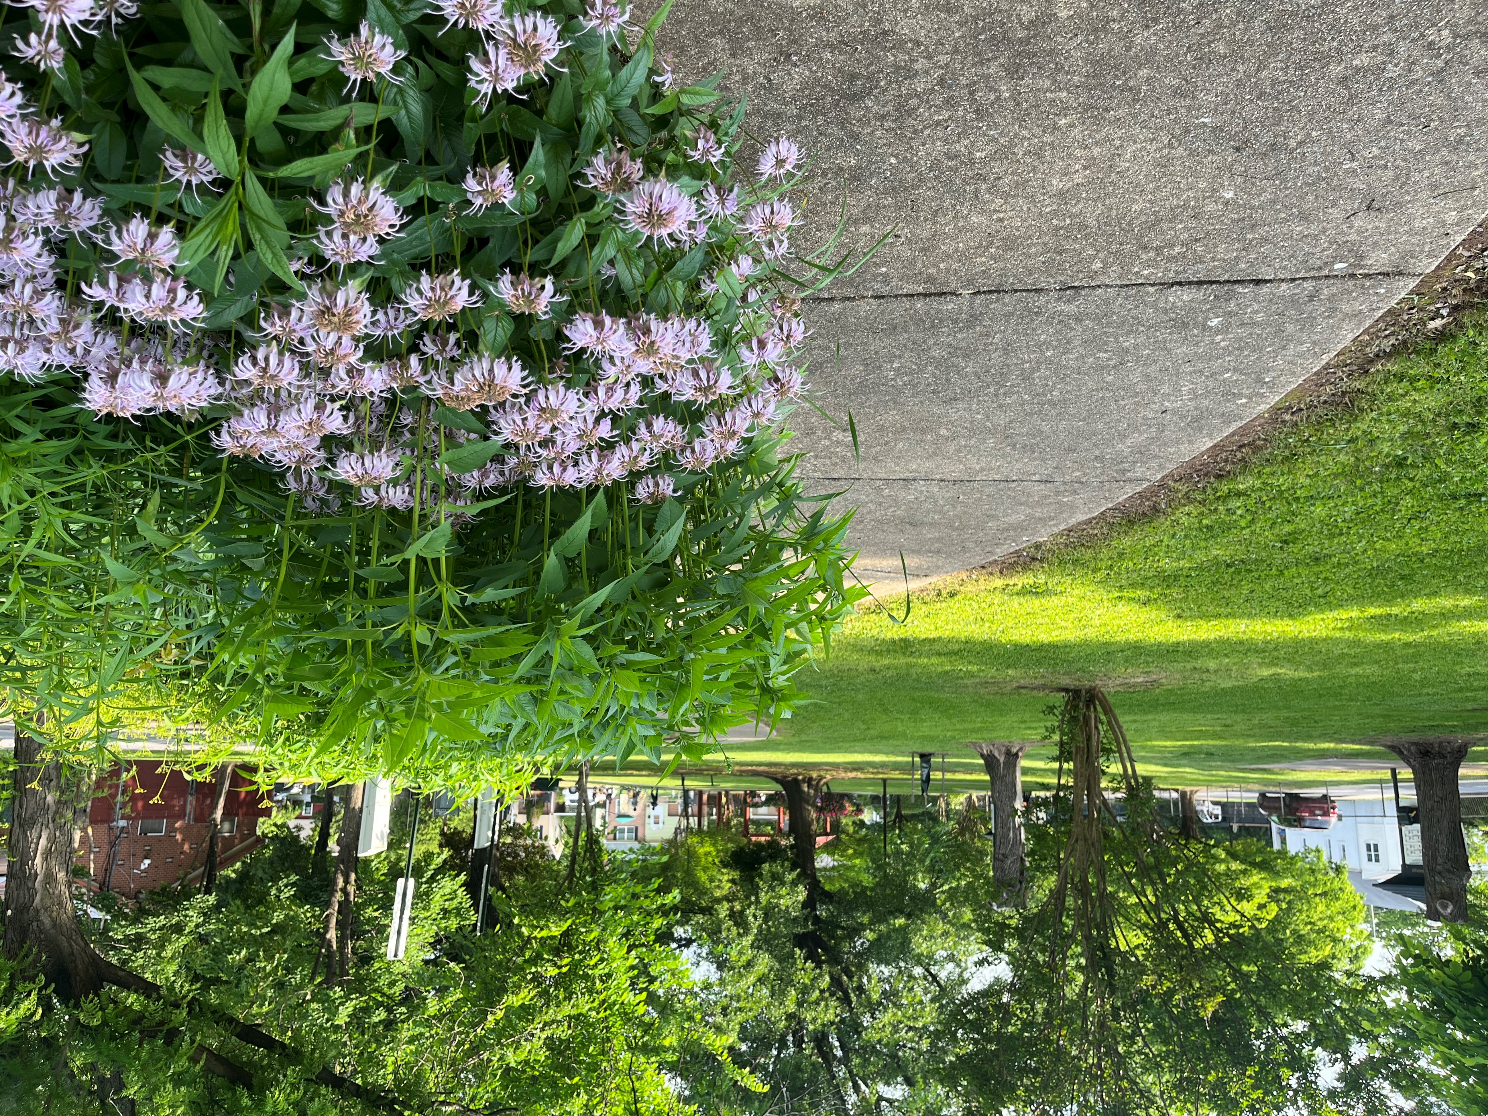
Activities
7/1 MNCPPC funding year begins
- Planning Assistance to Municipalities and Communities (PAMC) Program
7/6 Pepco Sustainable Communities Grant Program Application
- Community Resiliency awards
Urban Tree Grant & Blitz Project, Carole Barth
Following up with PG County Department of the Environment
NW Branch of the Anacostia River (dis)coloration, Brad Metzger
Contacted Water and Science Administration, Maryland Department of the Environment

