Slide 1

Town of Brentwood Council Update
June 20, 2023
Contact: cm3@brentwoodmd.gov

Slide 2
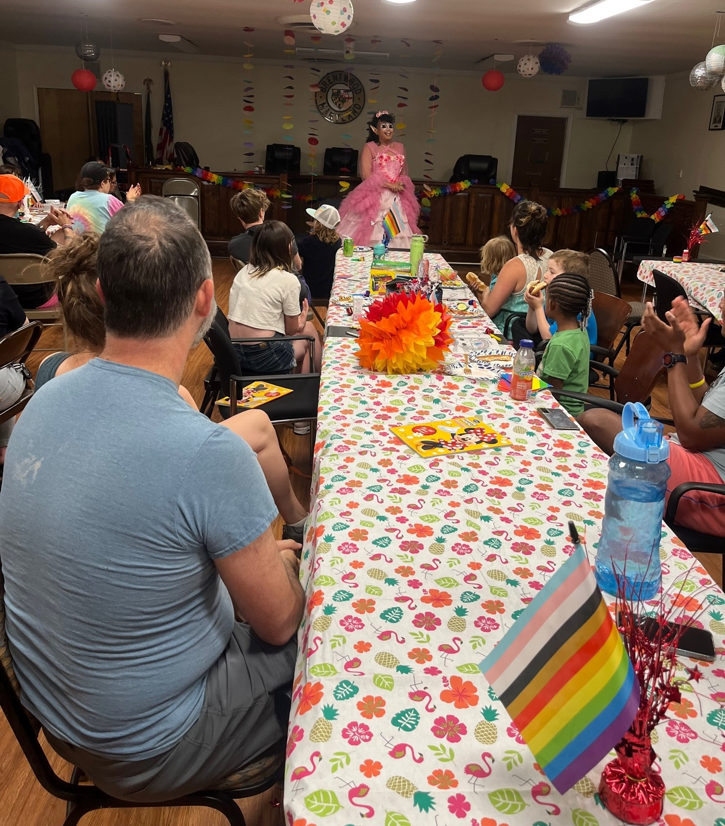
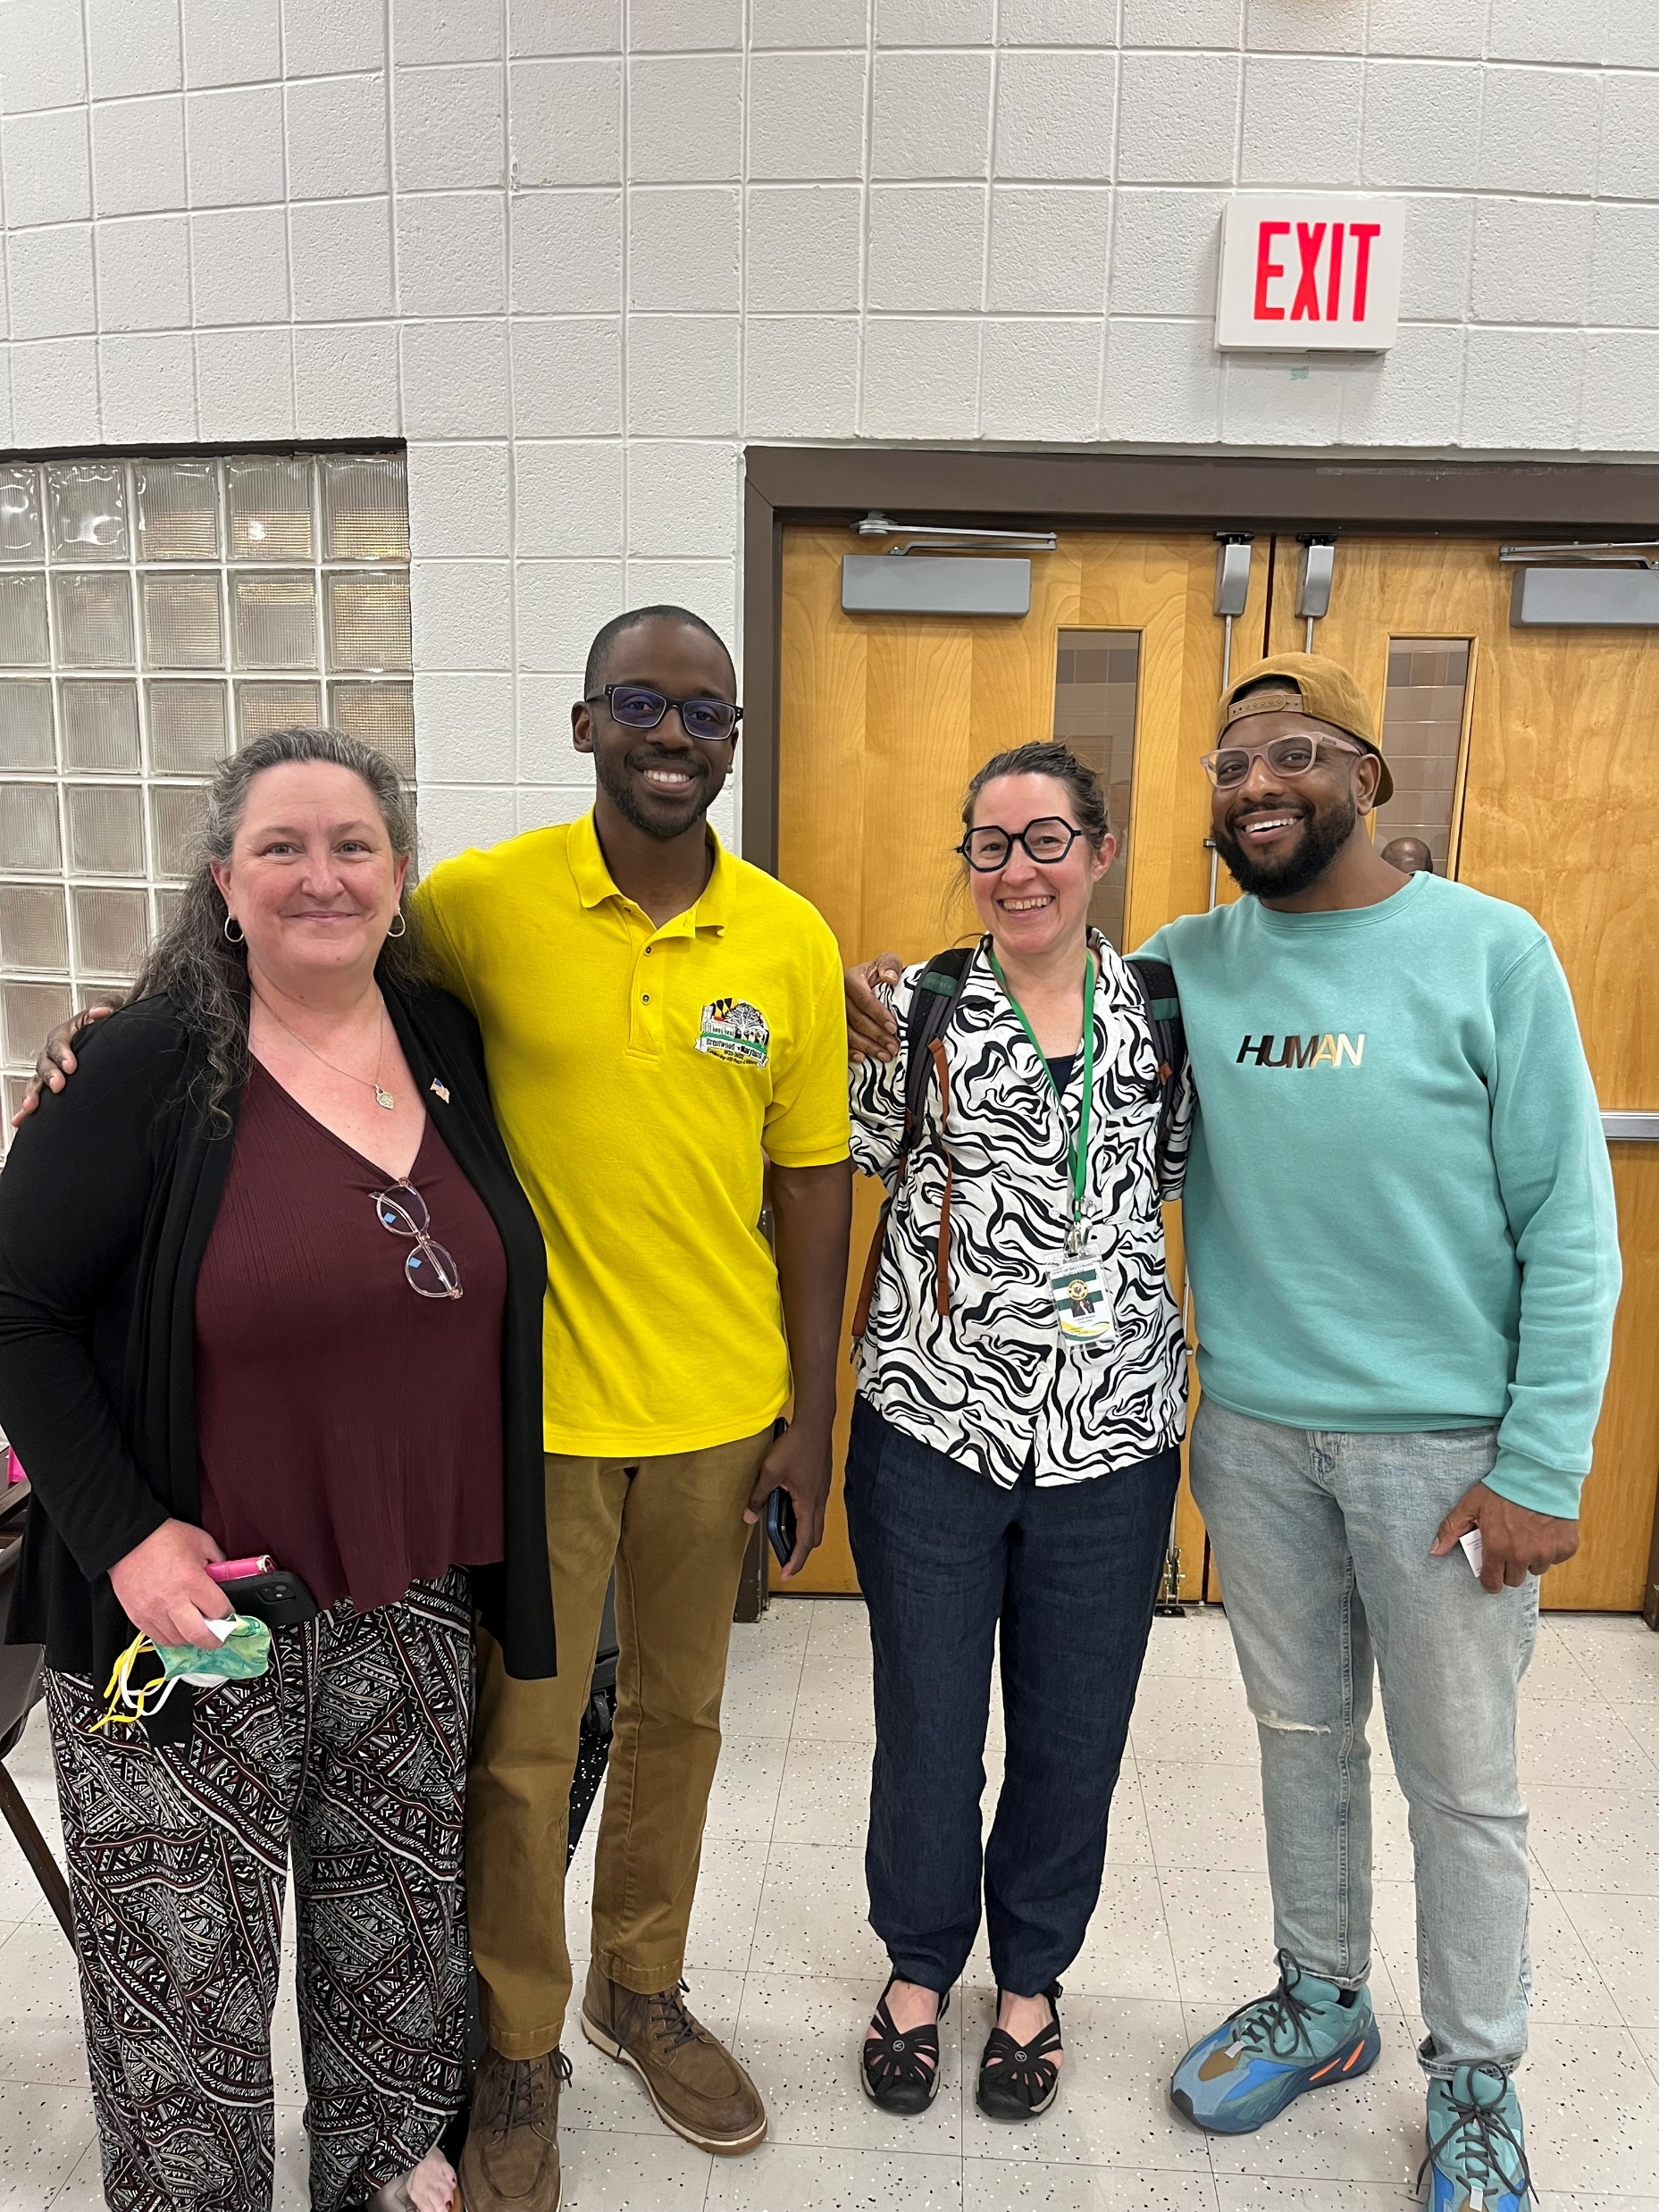
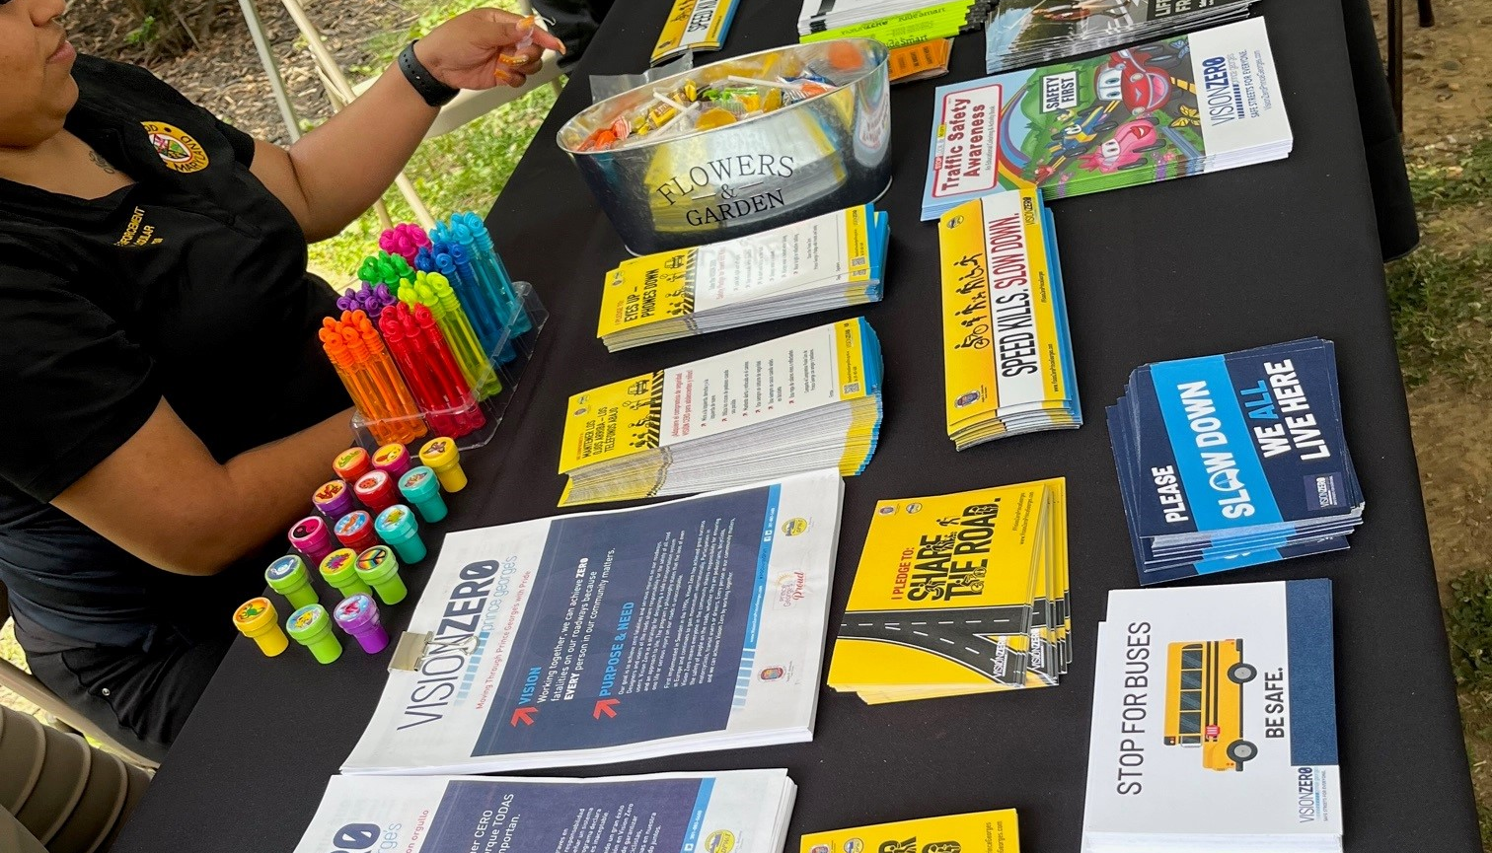
Councilmember activities
5/20 Attended Mt Rainier Vision Zero Task Force community meeting
5/24 Meeting with PG County Public School board representative Pamela Boozer-Strother
5/25 Attended PG County Councilmember Fisher’s Public Safety Town Hall
5/30 Attended Mt Rainier council meeting with Vision Zero Action Plan presentation
6/1 Attended WMATA Better Bus Network meeting
6/2 Meeting with Mt Rainier council members on SS4A / Vision Zero
6/2 Secured PG County Vision Zero tabling materials for BPD
6/5 Meeting with US Rep Ivey’s office grant coordinator
6/7 Meeting with D47 Quarterly Conversation with State Highway Administration
6/2 Brentwood Native Plant Network yard sign submission review
6/11 Meeting with Green Team co-chair
6/13 NLC Local Democracy Webinar
6/13 Pride Celebration & Drag Story Hour with support from Mt Rainier Mayor and North Brentwood council
6/14 Meeting with Maryland-National Capital Park and Planning Commission on Planning Assistance to Municipalities and Communities
6/14 Attended Pepco & Sustainable Maryland open office hours

Slide 3

Sustainable Brentwood Green Team Tree Committee

Slide 4
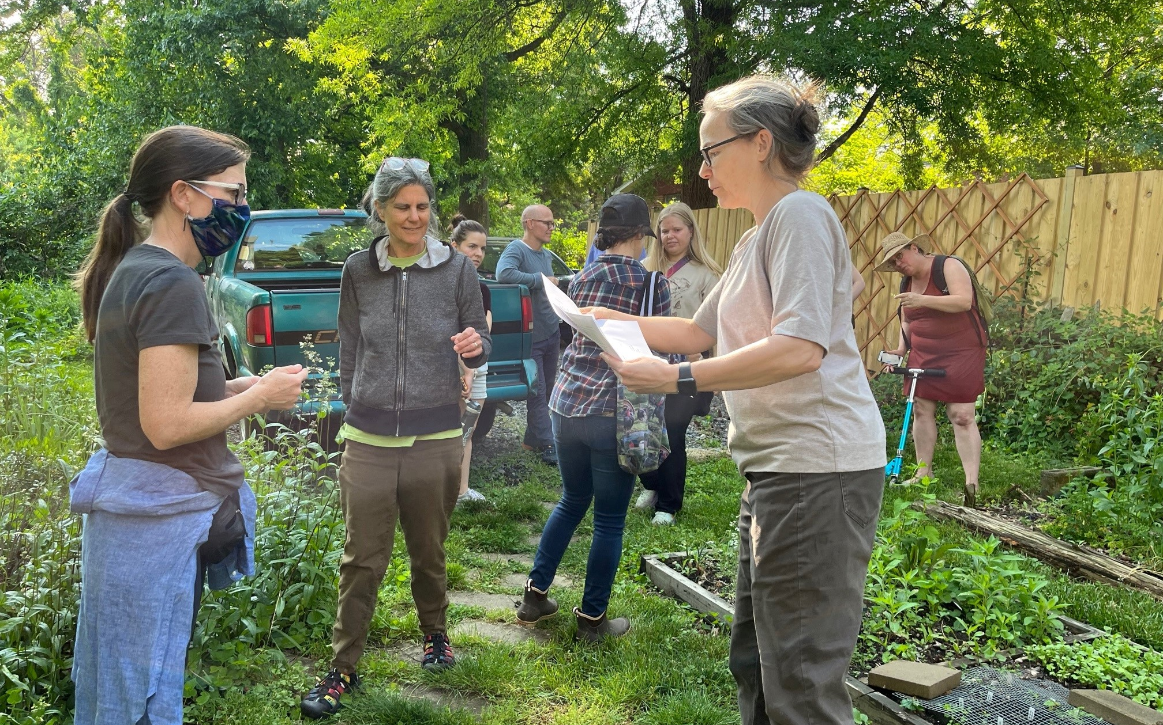
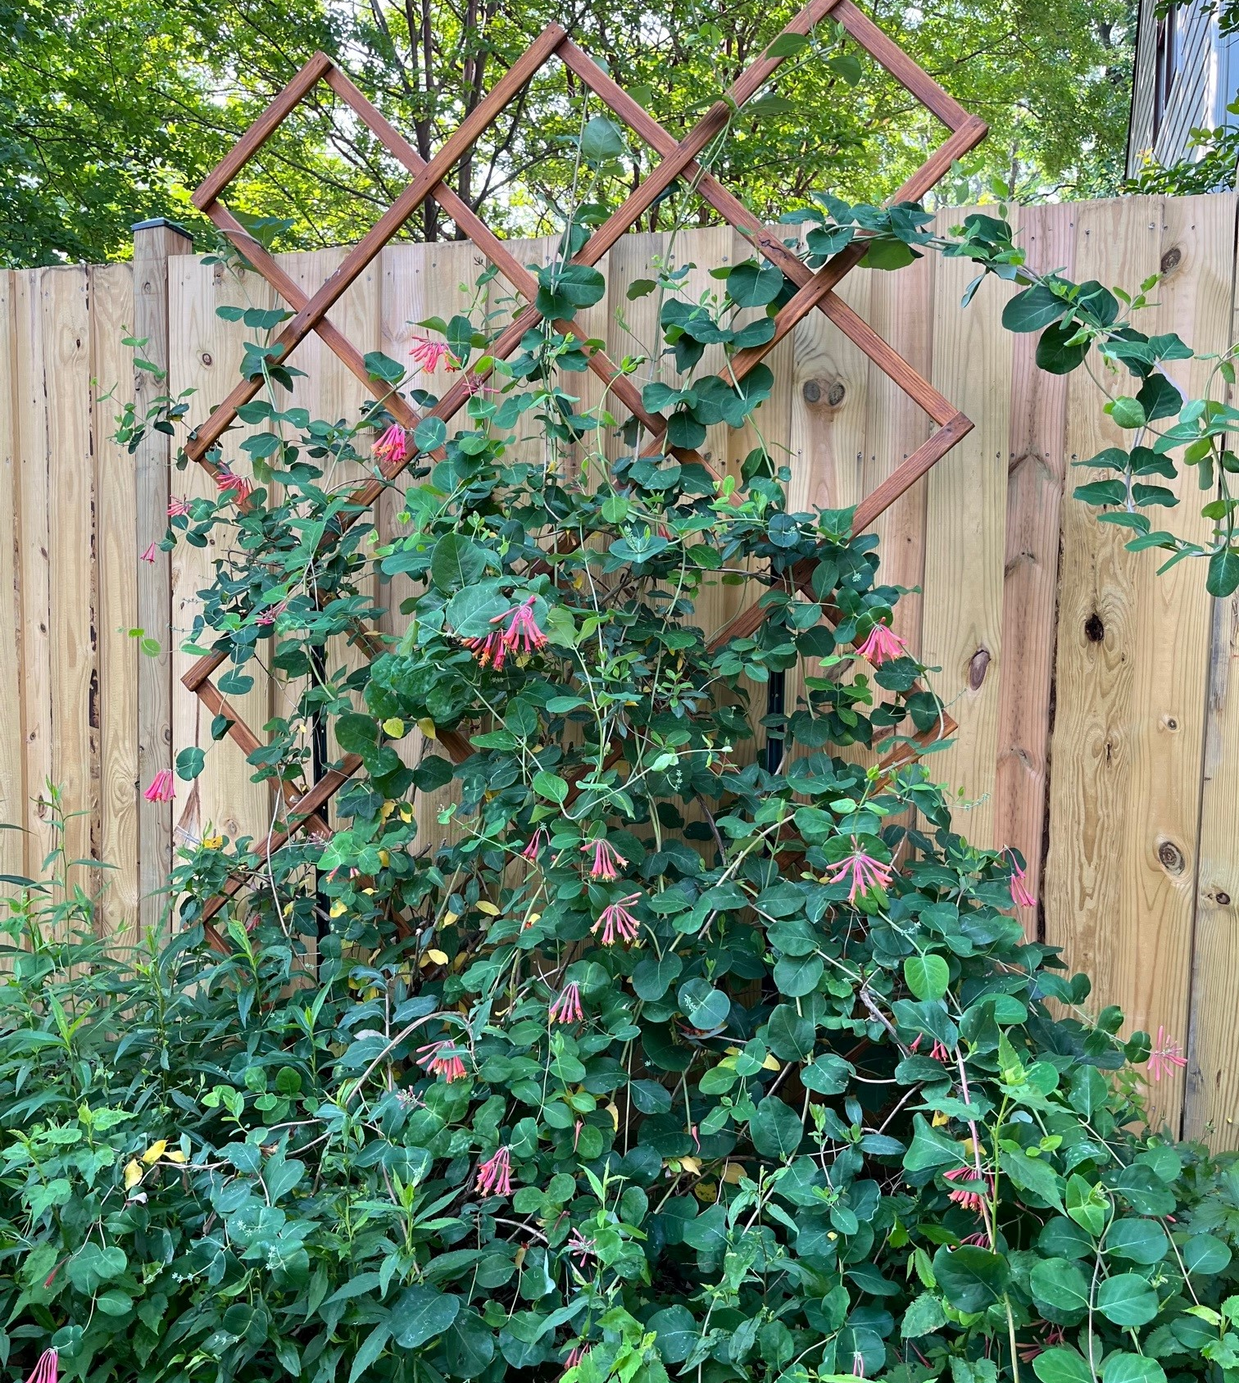
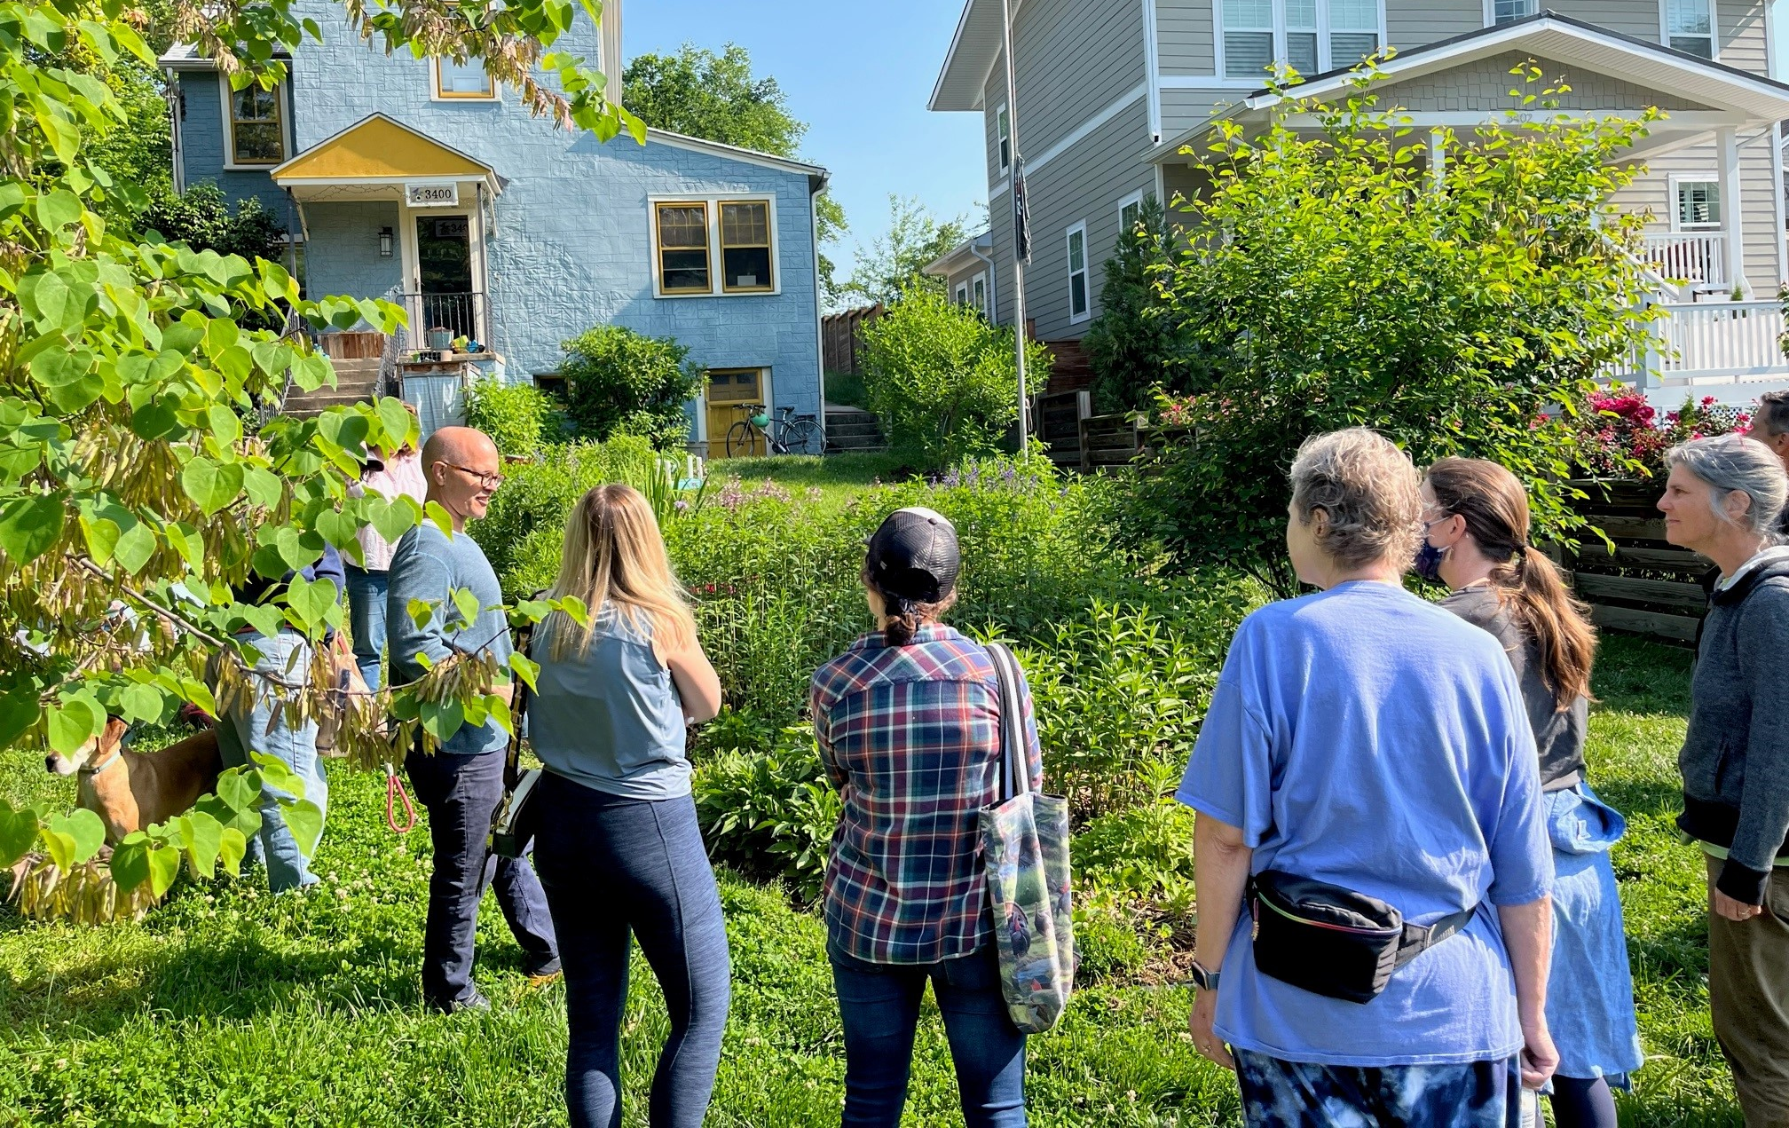
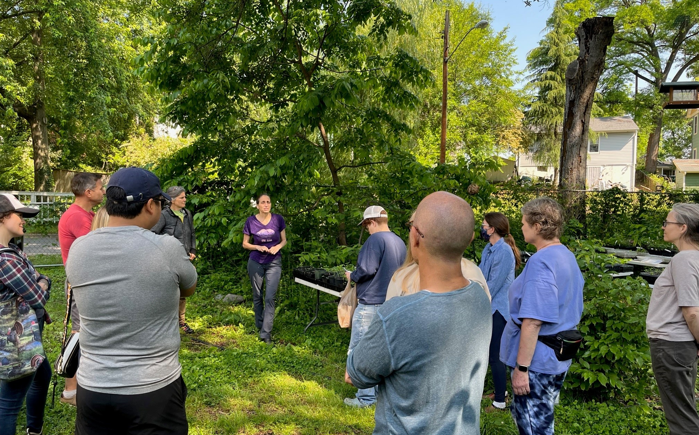
Brentwood Native Plant Garden Tour
Residents from Brentwood, Mt Rainier and Cottage City toured the park at Upshur & 34th Street and a few homeowner gardens and learned about:
  Turning a yard from grass to native garden
  Butterfly host plants
  What’s that plant really look like and do?

Slide 5
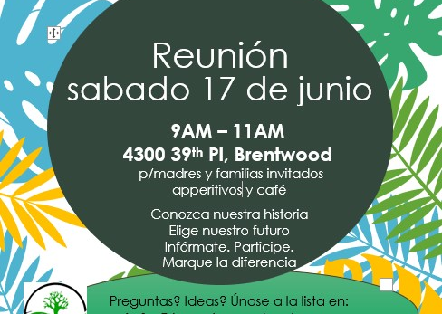
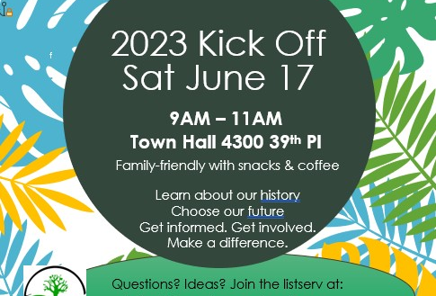
Events
6/3 Brentwood Day
The Sustainable Brentwood Green Team Tree Committee and Brentwood Native Plant Network table with plants from Chesapeake Natives, butterfly outdoor learning, activities for kids and information for families from NIH and Pollinator.org
6/17 at 9AM Sustainable Brentwood Green Team Tree Committee community gathering
Meet at Town Hall 4300 39th Place
Family-friendly with snacks & coffee
Learn about our proud heritage of environmental action
Choose our future actions
July & August gatherings TBD for Sustainable Brentwood Green Team Tree Committee
cm3@brentwoodmd.gov

Slide 6
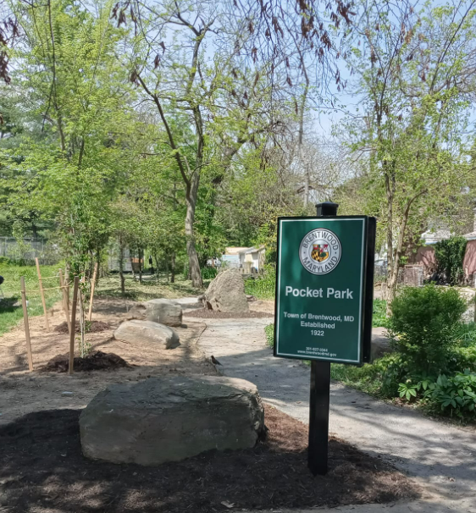
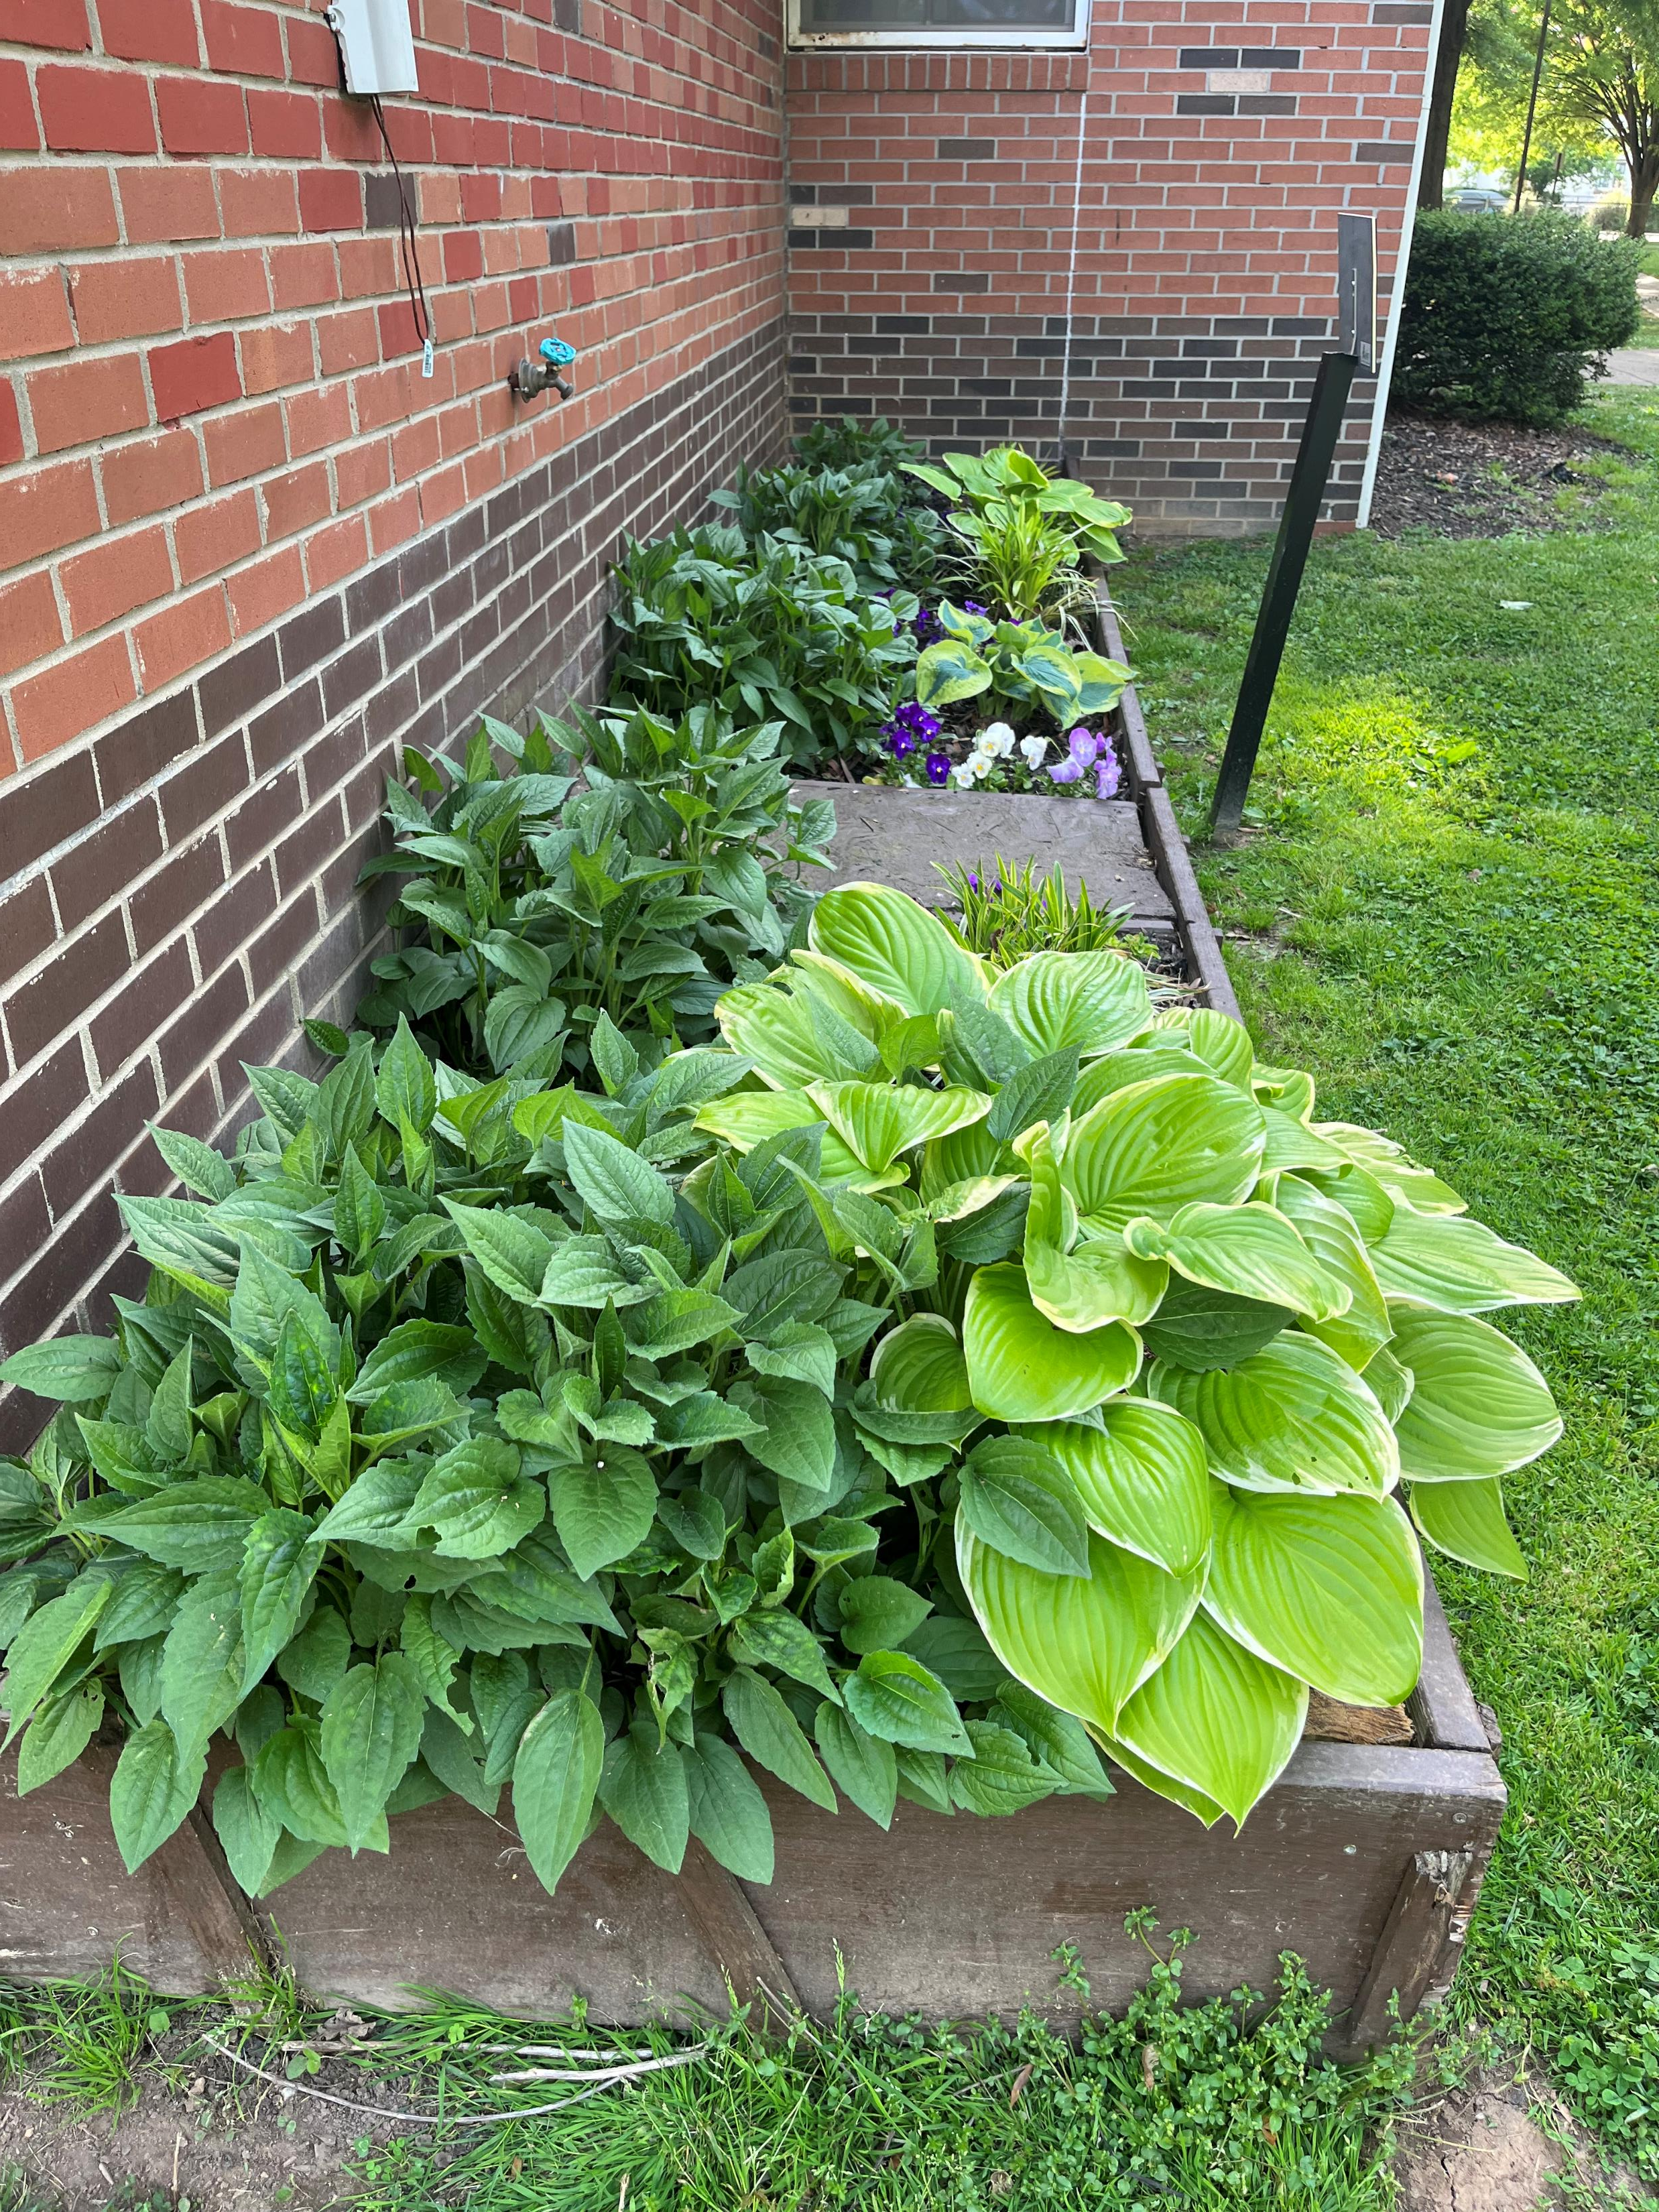
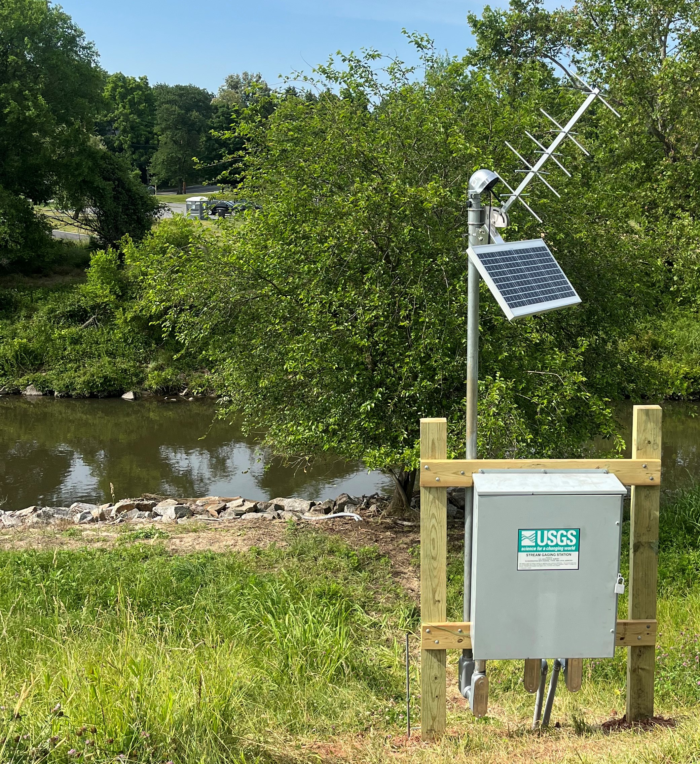
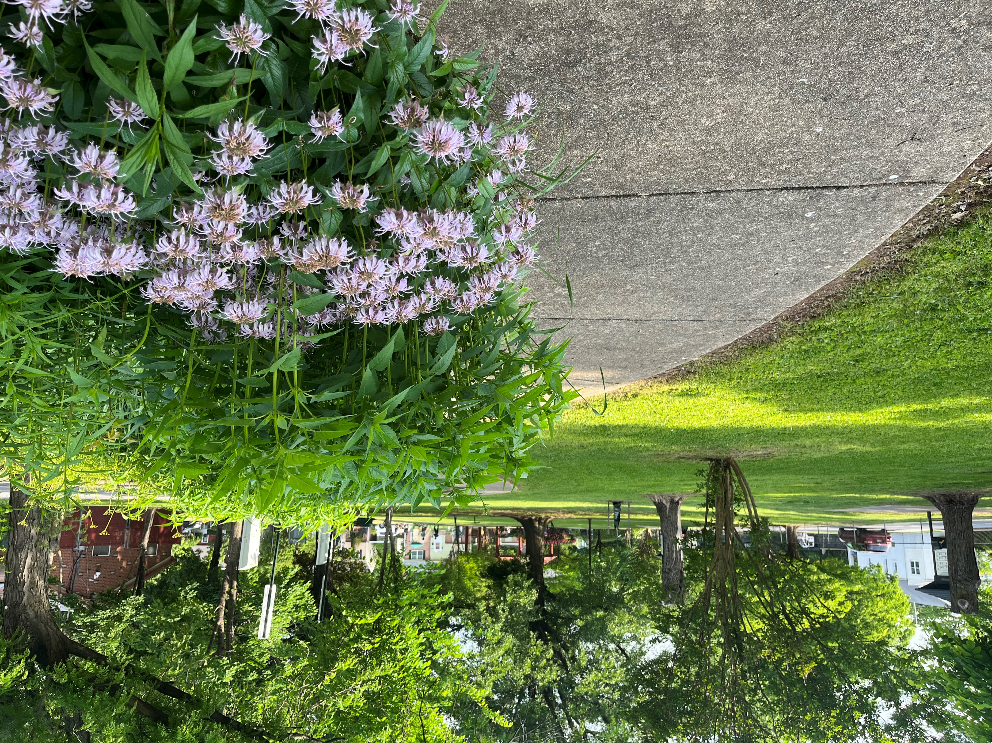
Activities
7/1 MNCPPC funding year begins
- Planning Assistance to Municipalities and Communities (PAMC) Program
7/6 Pepco Sustainable Communities Grant Program Application
- Community Resiliency awards
Urban Tree Grant & Blitz Project, Carole Barth
Following up with PG County Department of the Environment
NW Branch of the Anacostia River (dis)coloration, Brad Metzger
Contacted Water and Science Administration, Maryland Department of the Environment

Slide 7
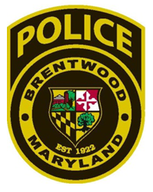
Brentwood Public Safety Committee

Slide 8
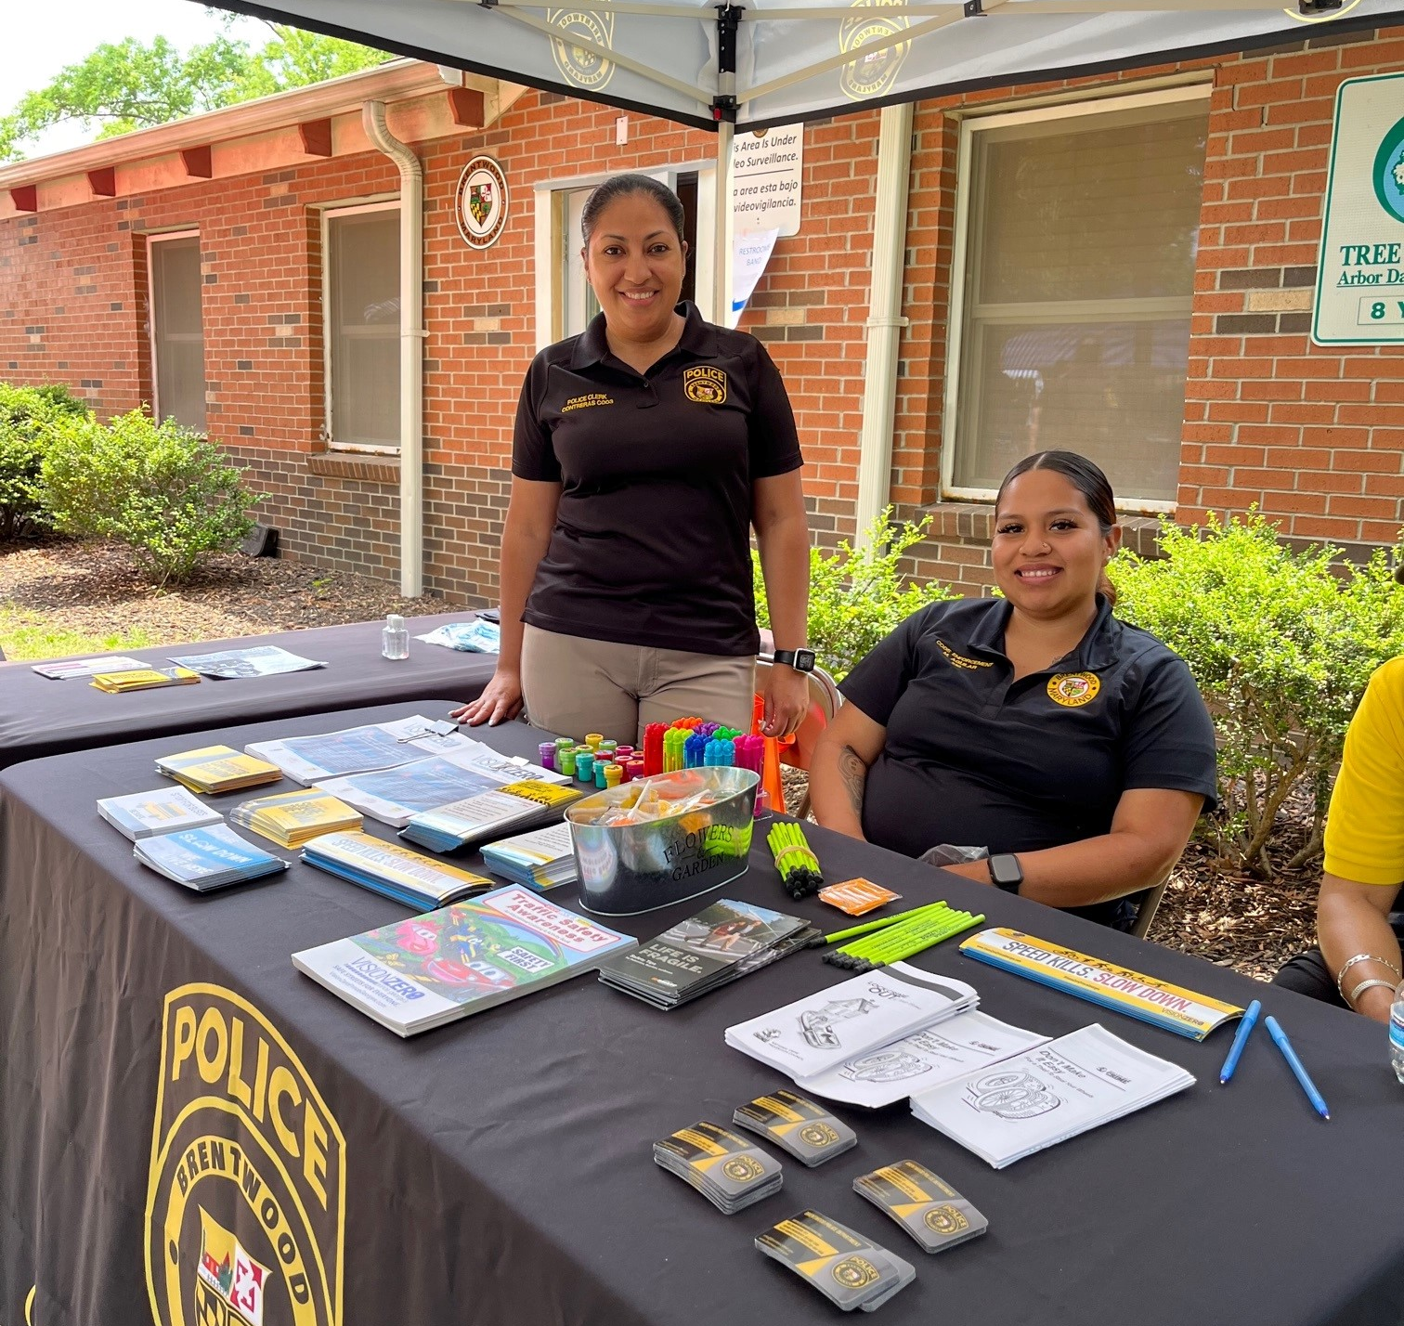
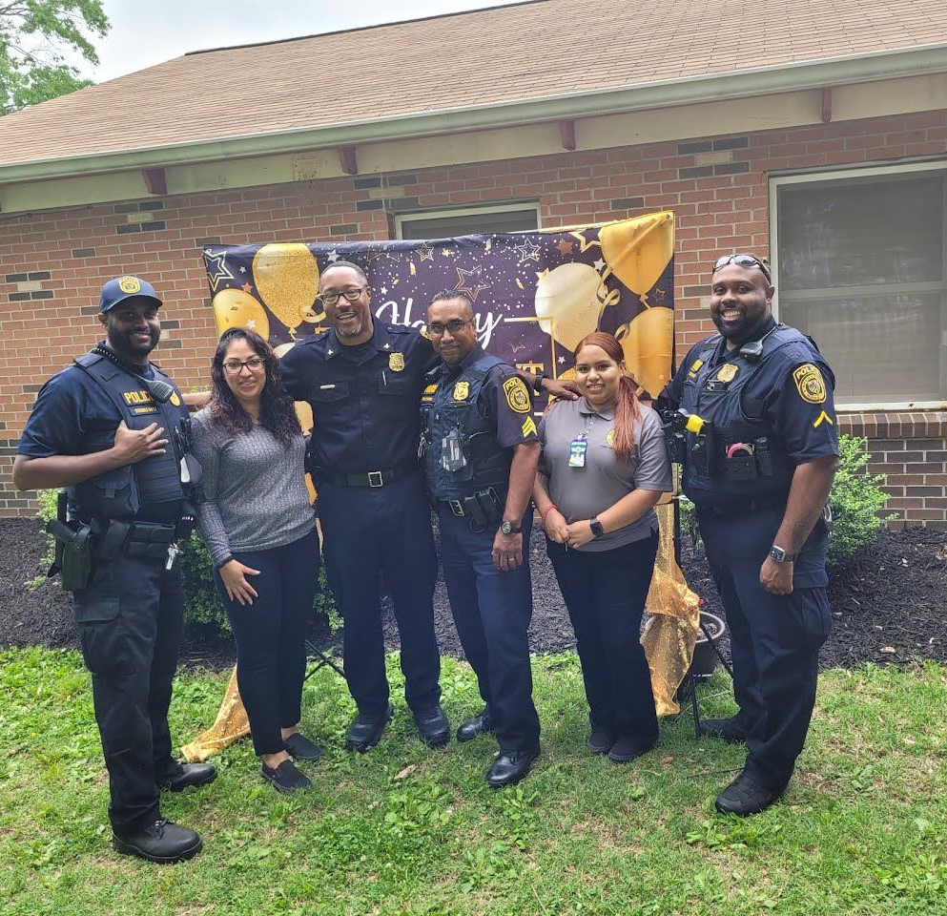
Activities & Events
7/6 at 10AM Public Safety Committee community gathering
Resolution 2017-03: Comprised of residents, businesses and community stakeholders to represent and advocate for the public safety needs and interests of the collective community in the Town of Brentwood and to advise the Chief of Police on matters related to community safety and welfare.
2023 focus: National Night Out with Back-to-School event (supplies drive and safety tips)
Preparing data for Safer Streets and Roads for All grant application
Preparing for August 1st National Night Out and Back-to-School event with supplies drive and safety tips

