Slide 1
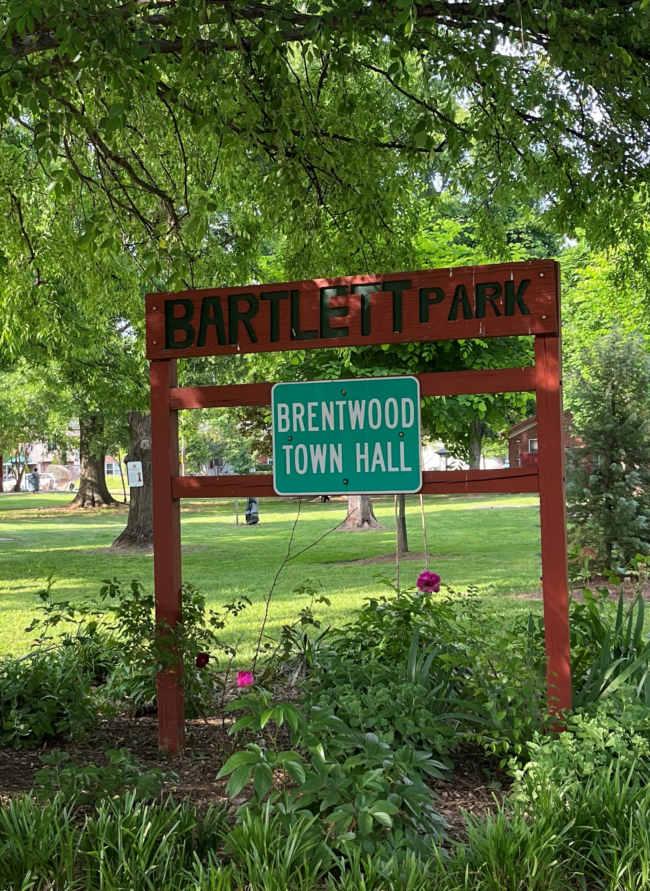
Town of Brentwood Council Update
August 22, 2023
Contact: cm3@brentwoodmd.gov

Slide 2
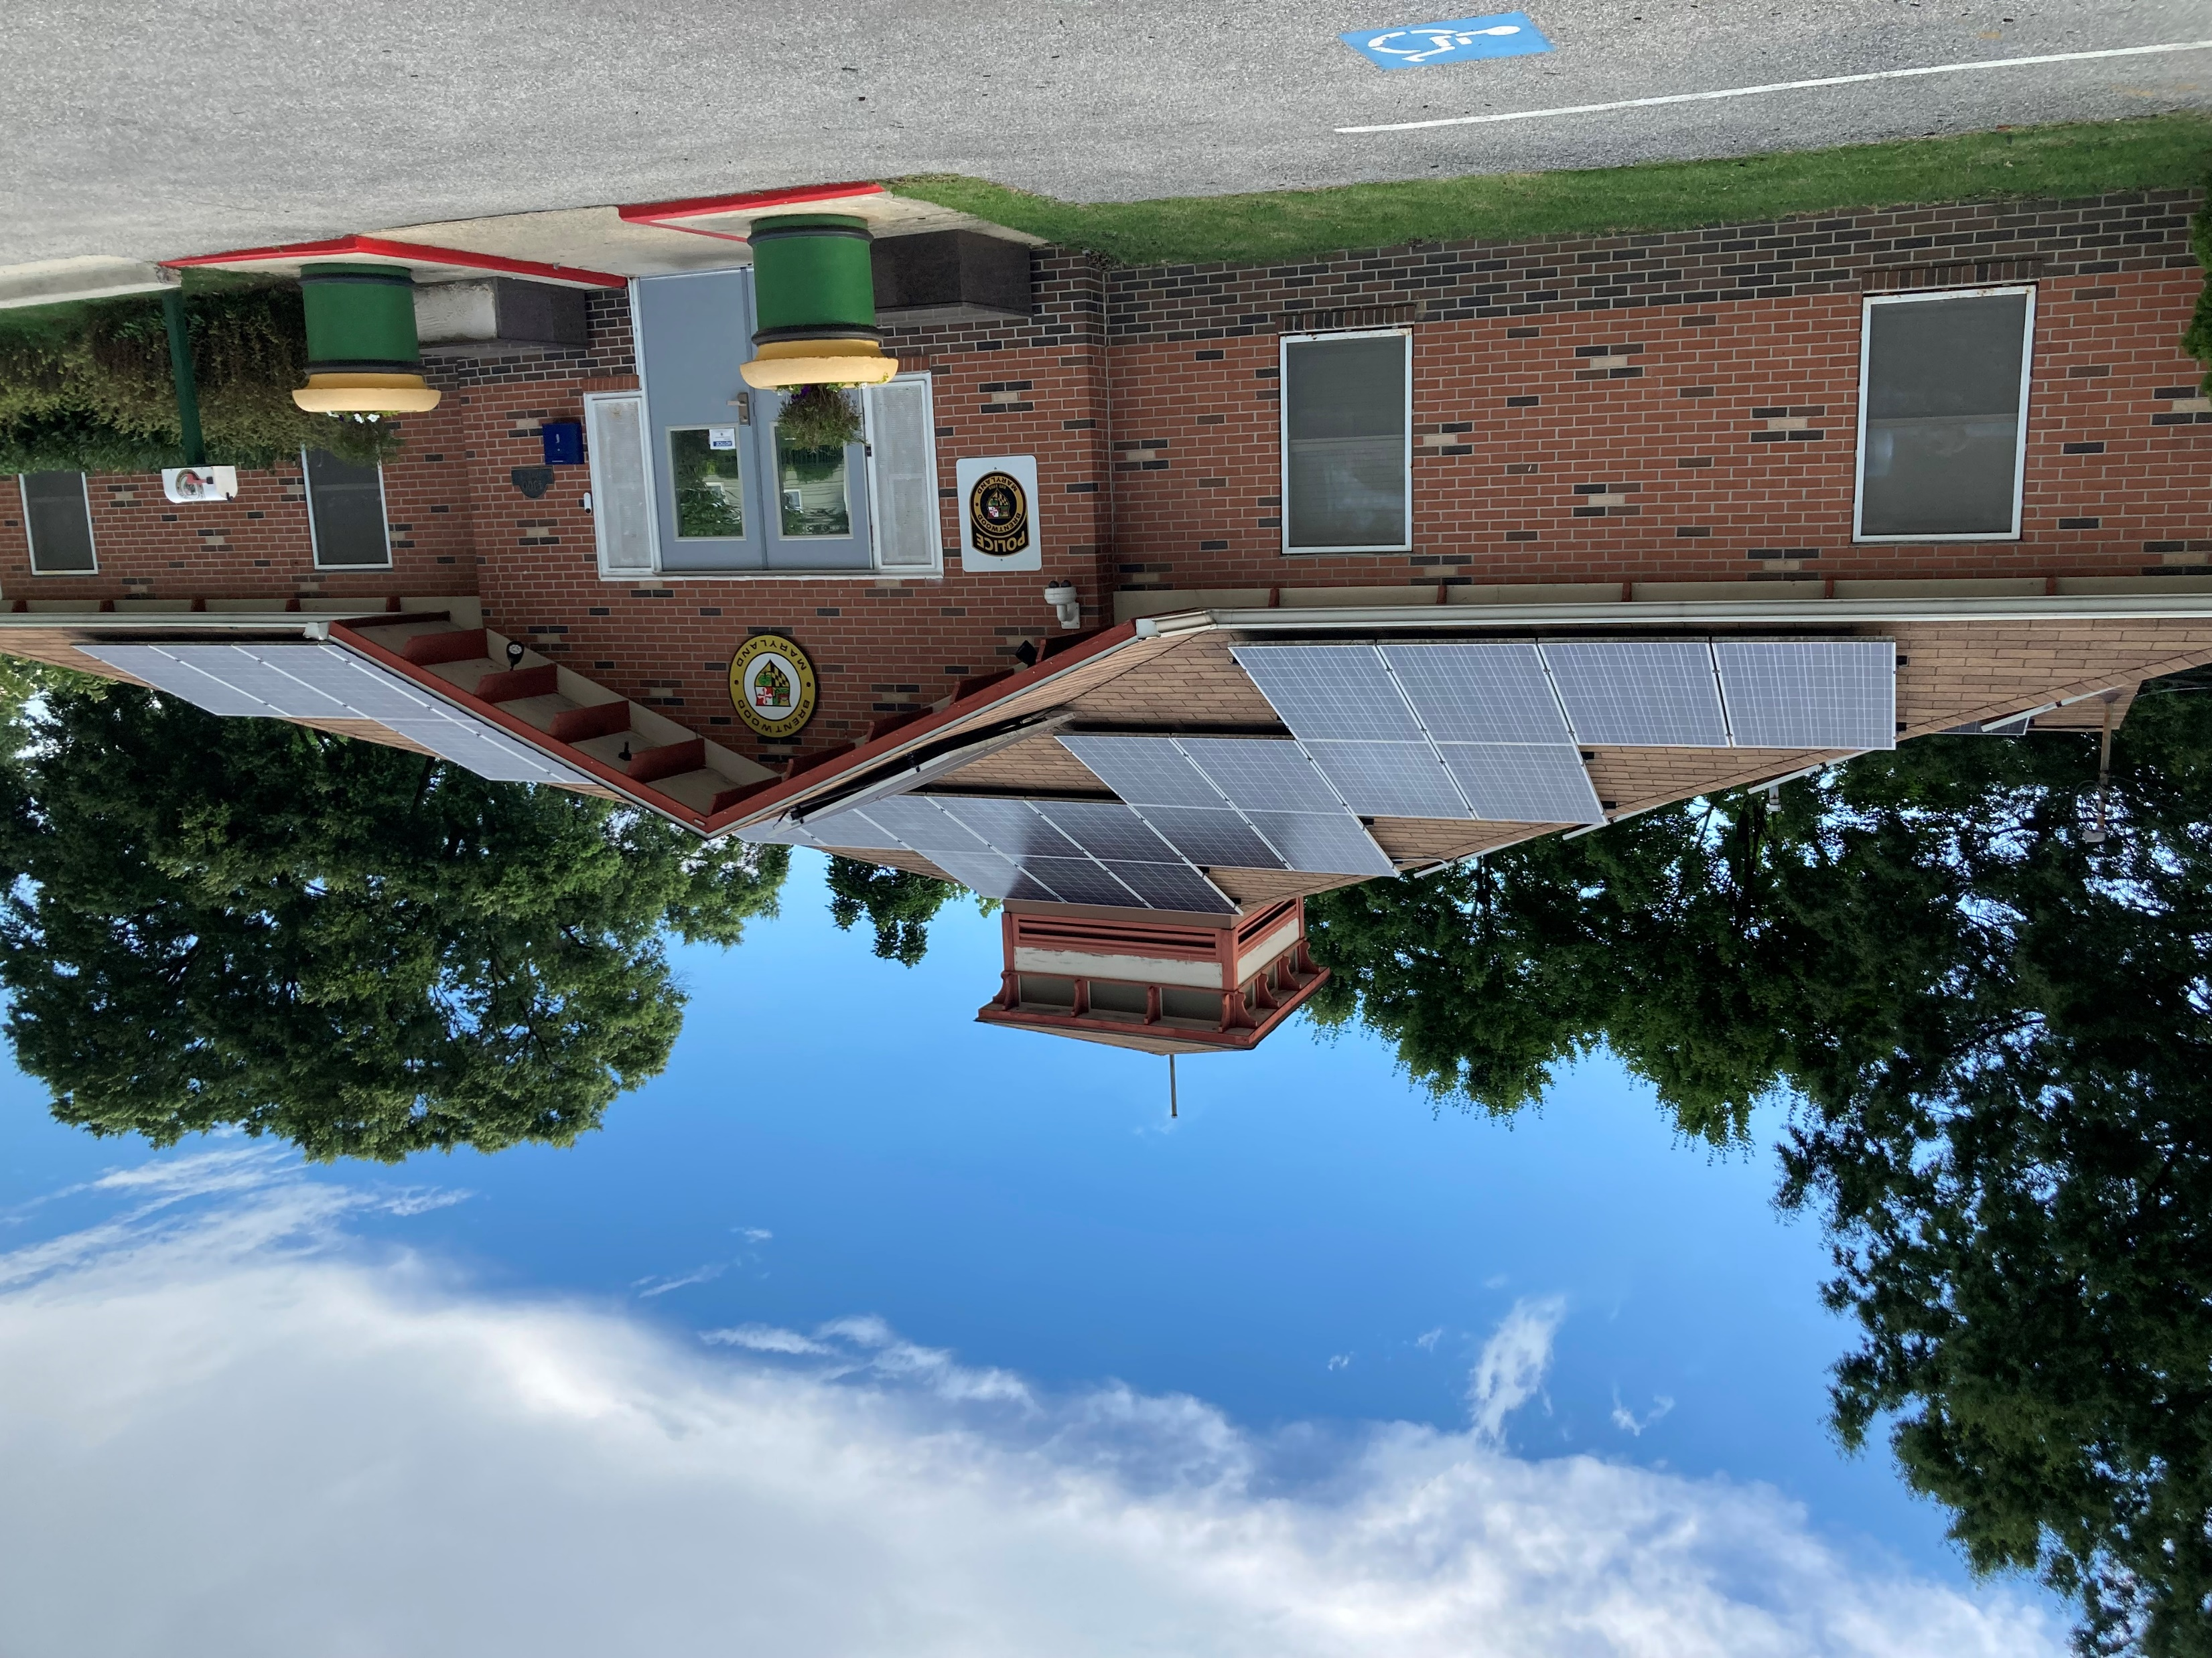
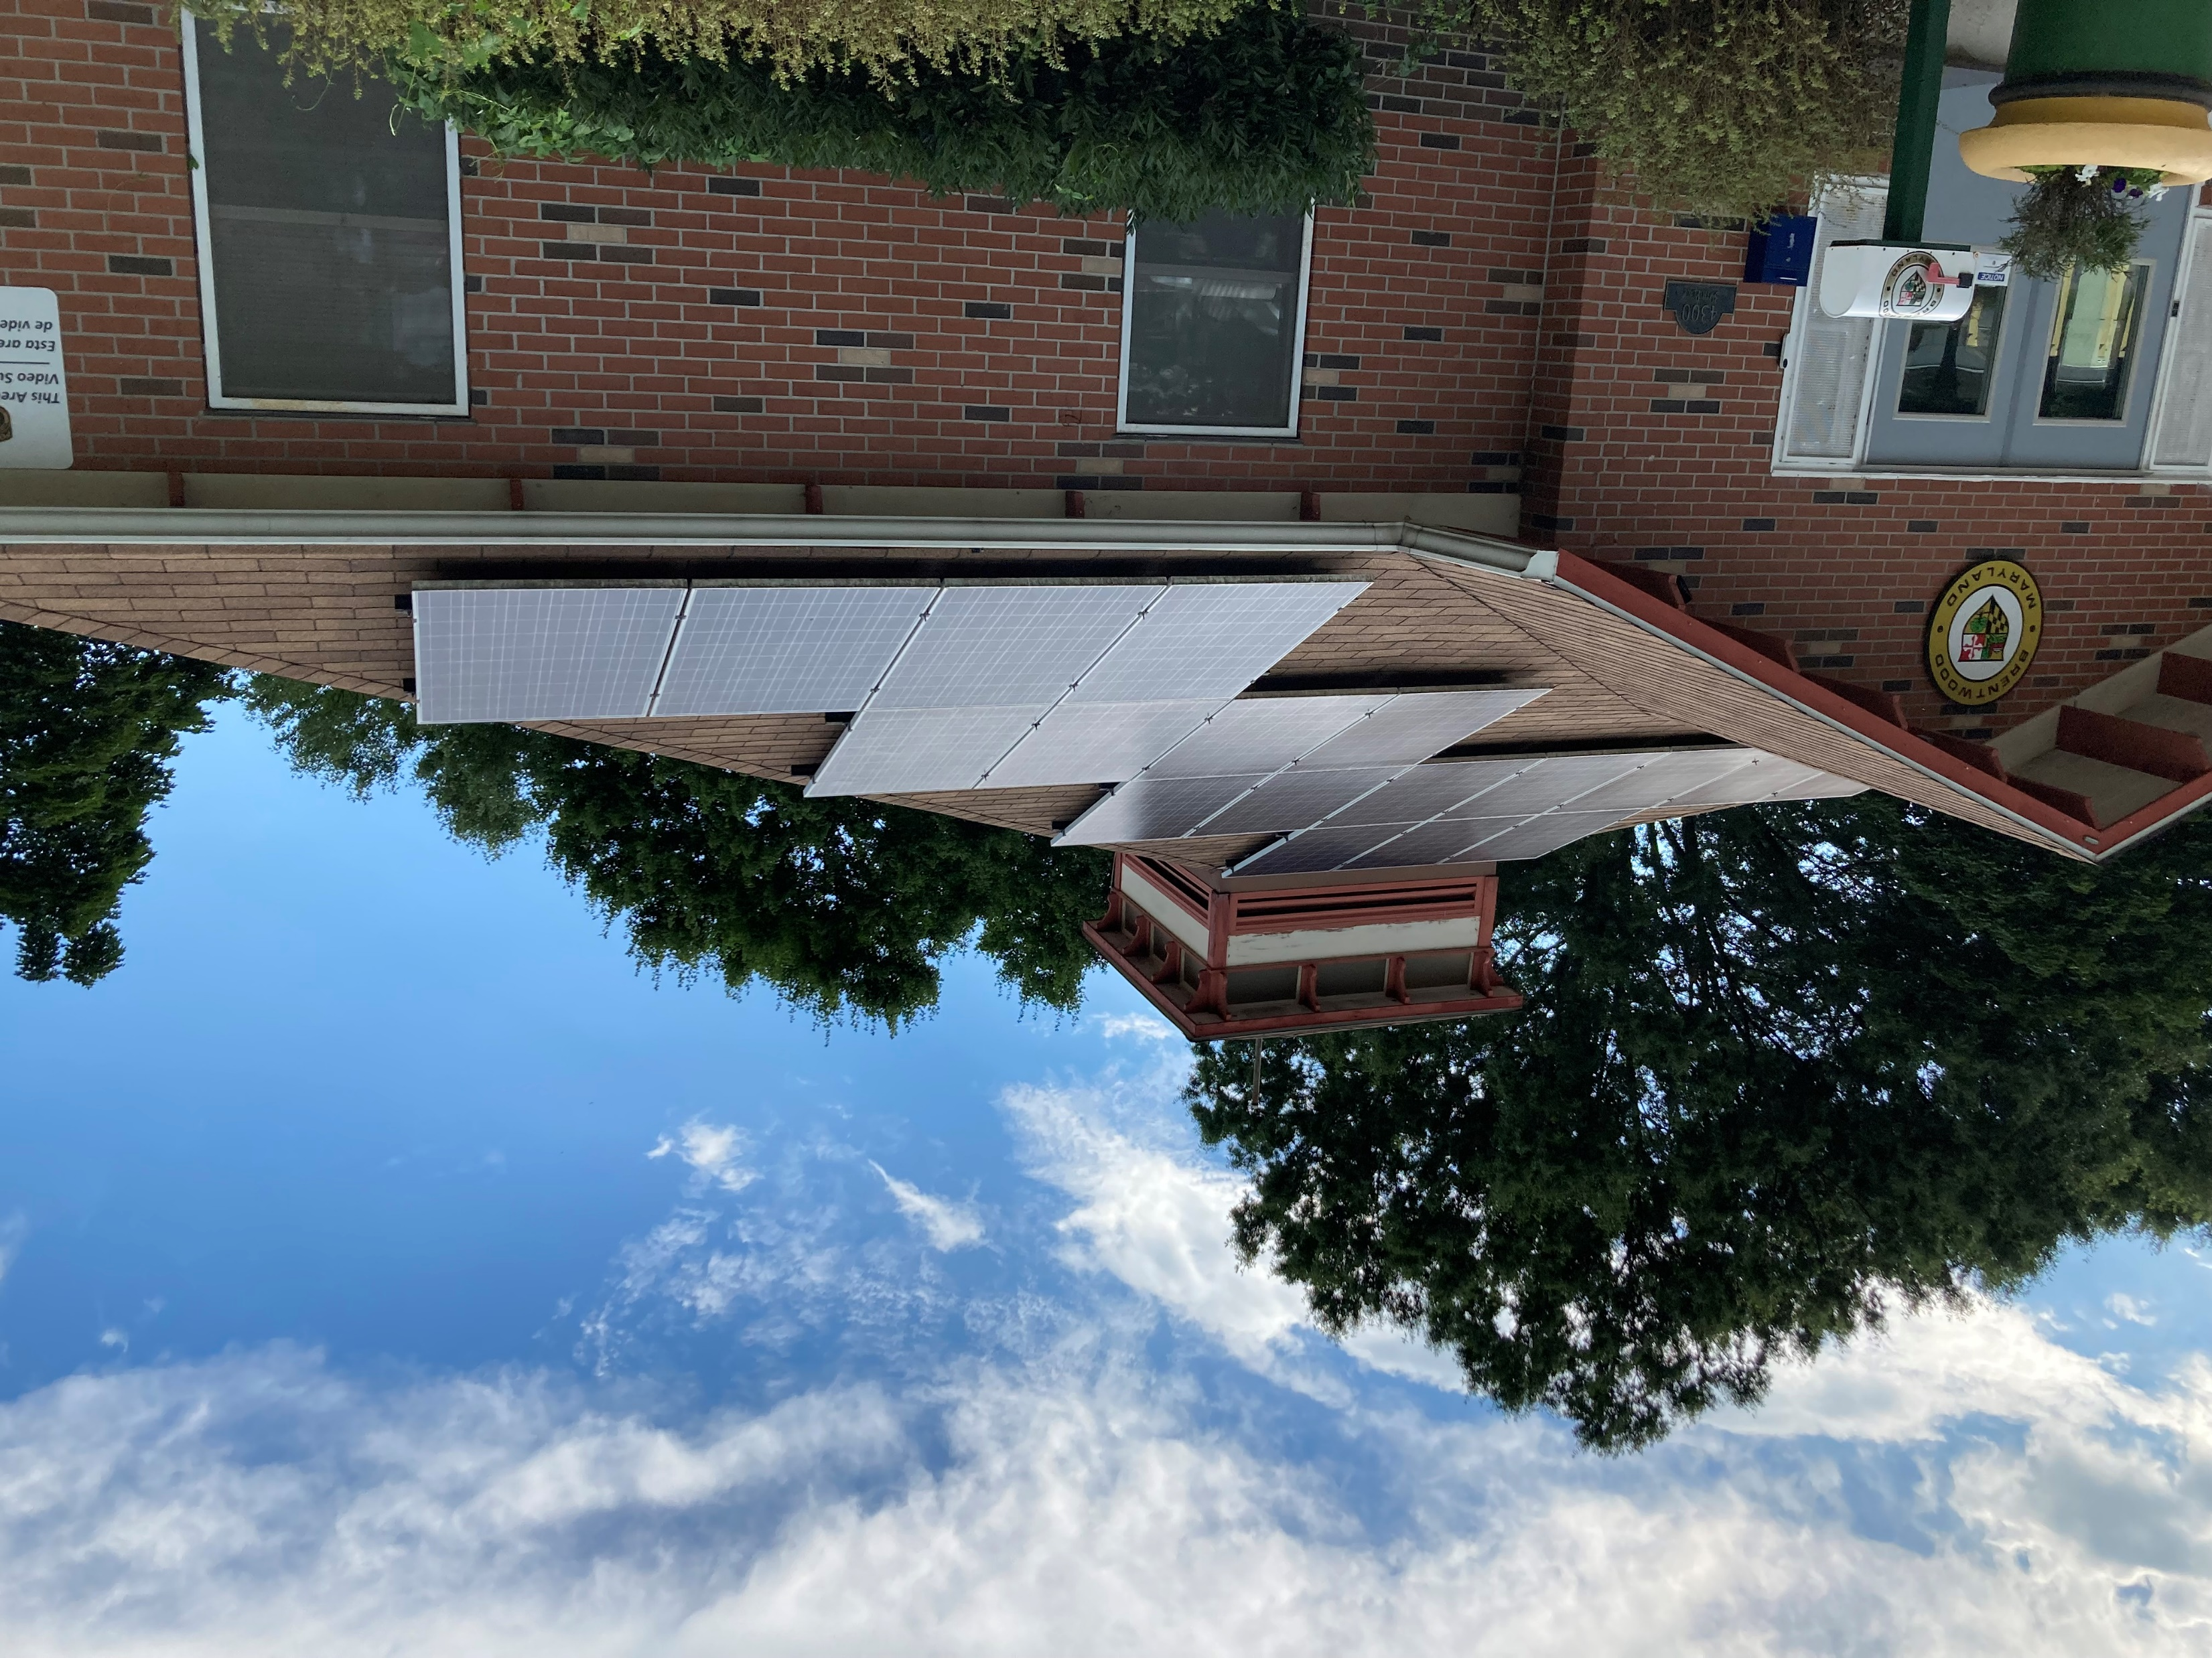
SolSmart
NEW
Resolution that the Town of Brentwood participate in the SolSmart program
National League of Cities SolSmart
Led by the Interstate Renewable Energy Council (IREC) and the International City/County Management Association (ICMA) and funded by the U.S. Department of Energy Solar Energy Technologies Office.
To date, 500 local governments in 43 states, the District of Columbia, the U.S. Virgin Islands, and Puerto Rico have achieved SolSmart designation, representing over 139 million people.
The program provides no-cost technical assistance to help local governments follow national best practices to expand solar energy use in their jurisdictions – municipal, residential, businesses, non-profits, etc.
The SolSmart criteria pathway is organized into five categories: Permitting and Inspection, Planning and Zoning, Government Operations, Community Engagement, and Market Development. Within each category are specific actions that municipalities, counties, and regional organizations can take to encourage local solar energy use.

Slide 3
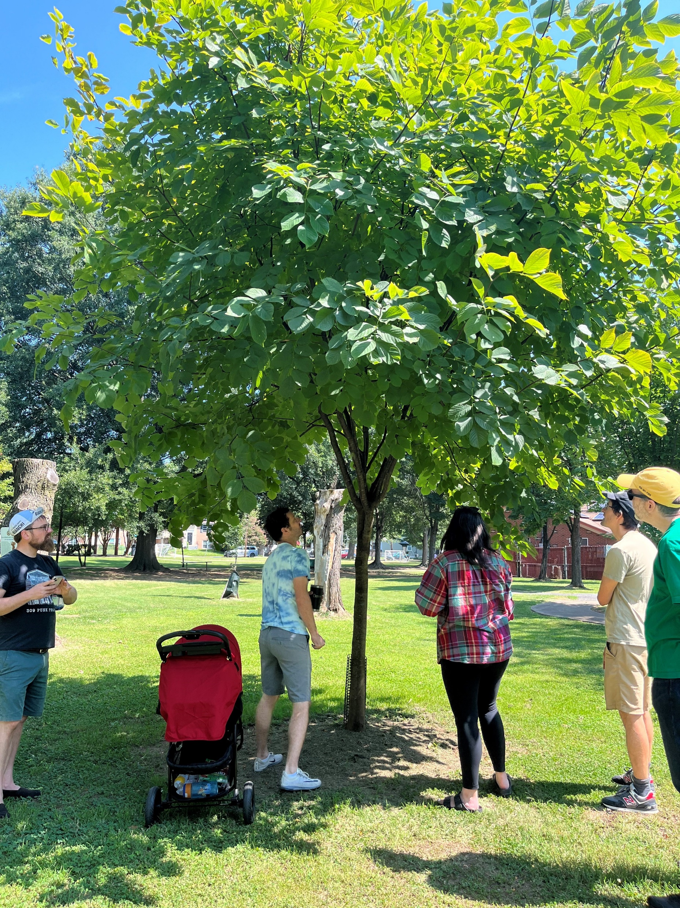

Updates
Maryland-National Capital Parks and Planning Commission (M-NCPPC) Planning Assistance for a Municipalities and Communities (PAMC) will be issuing the Request for Proposals soon for the
Climate Action Plan, including resident, business and stakeholder engagement opportunities
Flood assessment and mitigation strategies
Town of Brentwood withdrew from the Pepco Sustainable Communities grant due to conflicts with the MNCPPC planning.
Tree Committee meetings 7/31 and 8/20
Maryland 5 Million Trees initiative participation (contacted CBT)
November invasive vine removal training and action (contacted Hyattsville)
Tree Care policy or practices analysis and proposal for Town of Brentwood for municipal and residential tree planting and maintenance
Plan for 2024 and 2025 Arbor Day event
Green Team
Conducting analysis for key actions and drafting 2023-2025 Action Plan
Brentwood Native Plant Network greensbrentwood@gmail.com
Yard certification for native plants from September to October
Yard sign complete on 8/31 – share at the 9/5 council meeting & sent for printing

Slide 4
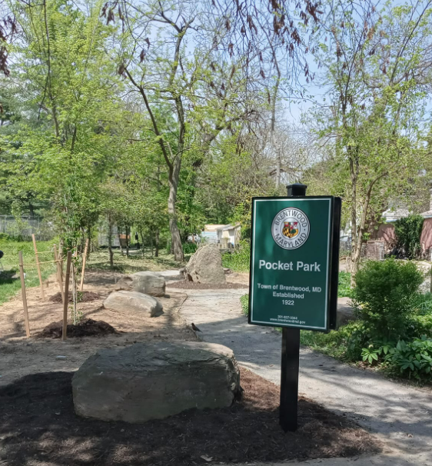
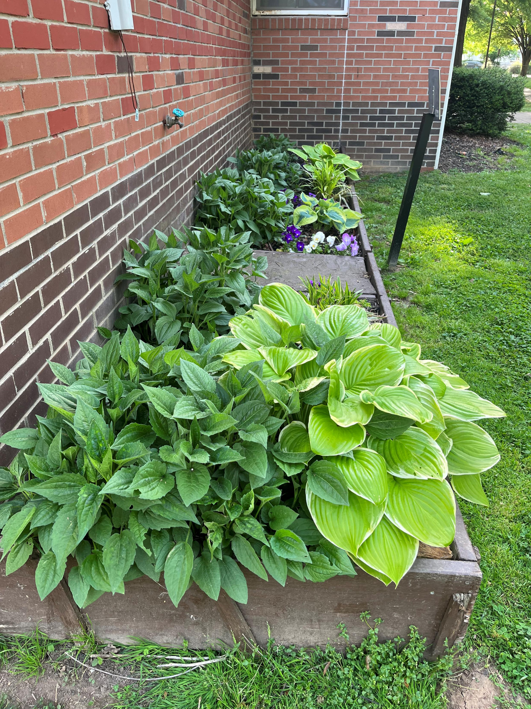
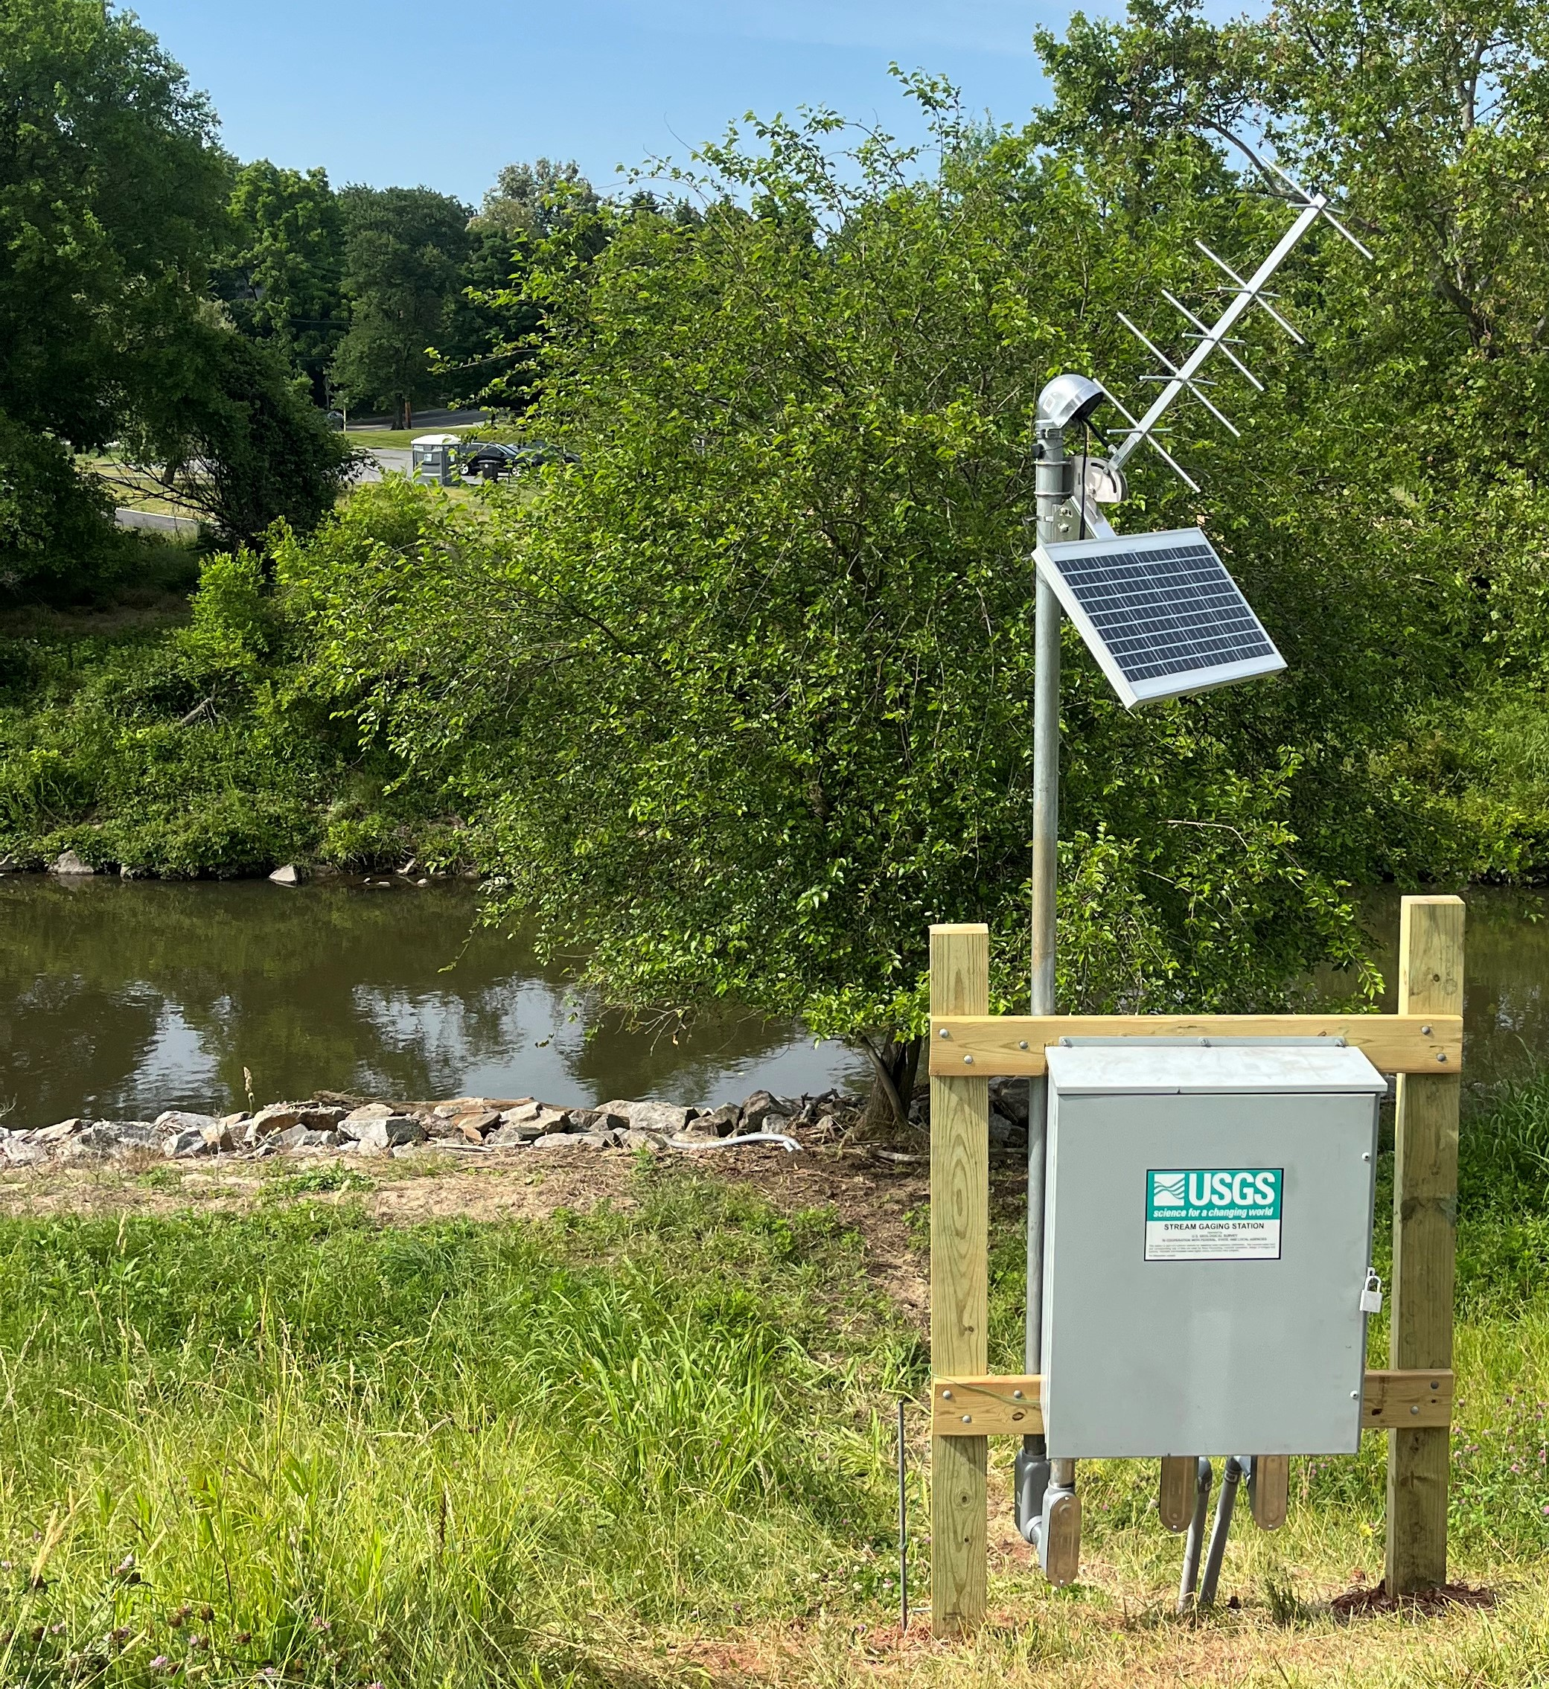
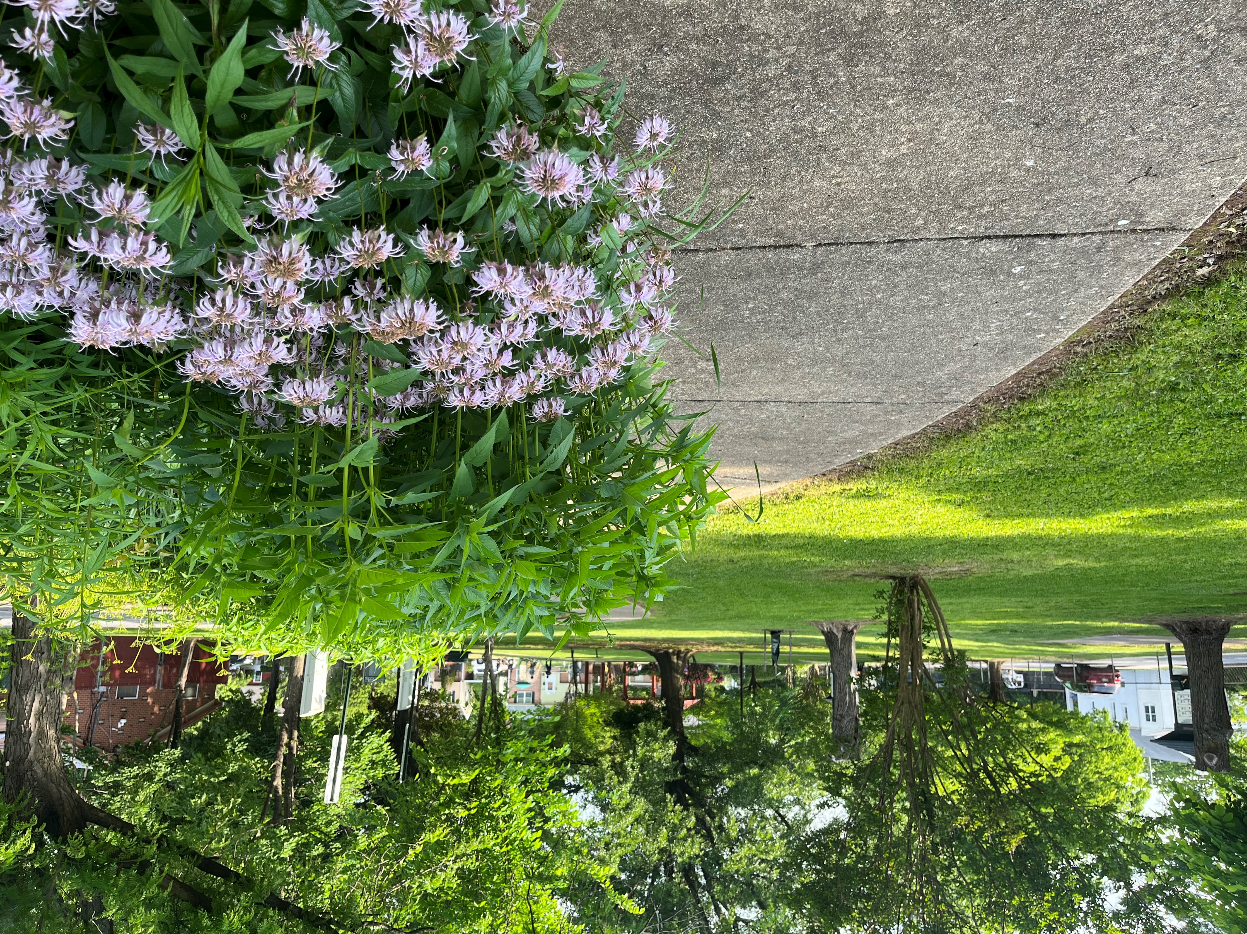
Upcoming Activities
8/29 at 9AM Thomas Stone Elementary beautification including pollinator garden maintenance
September date change for Sustainable Brentwood Green Team Tree Committee meeting
September Tree Committee meeting is being scheduled
Brentwood Native Plant Network
Certifications from September to October contact greensbrentwood@gmail.com to get your yard certified as a native plant garden

Slide 5
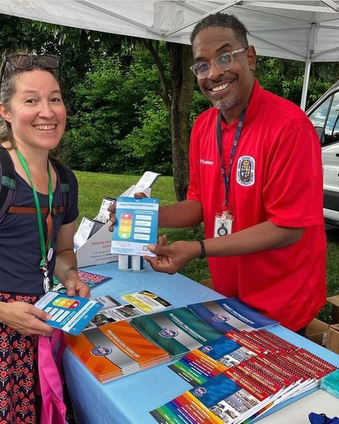
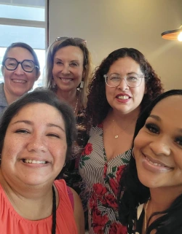
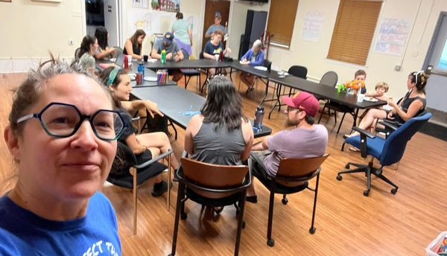
Councilmember July-August activities
Met with Metropolitan Washington Council of Governments and Anacostia Watershed Community Advisory Committee, which provides community input to the Anacostia Watershed Restoration Partnership, a consortium (led by MWCOG) of local, state, and federal agencies, environmental organizations, and private citizens working toward a cleaner, healthier watershed.
Met with Anacostia Riverkeeper
  Volunteer program that monitors water quality at 38th Street Park and provides bi-weekly results
  Swim and fish responsibly. Don’t swim 72 hours after a rain.
Attended Maryland Energy Administration’s inaugural Solar Incentives Task Force meeting – studying the impacts of solar energy in Maryland and making sure that the state meets the solar energy goals established in the State’s renewable energy portfolio standard.​ ( more info)
Attended Coalition for Smarter Growth’s conversation with Prince George’s County Planning Board Chair Peter Shapiro
Attended Senator Malcolm Augustine’s District 47 Leadership Breakfast with Q&A with new Prince George’s County Public Schools Superintendent House
Participated in Nature Everywhere webinar (supports outdoor education)
Attended Sustainable Maryland open hours

