Slide 1
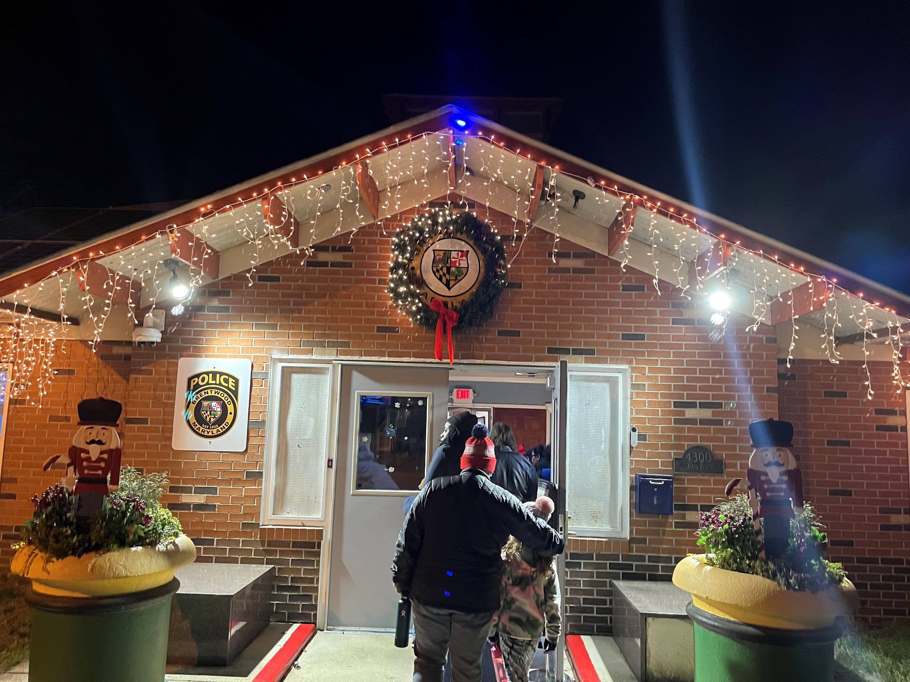
Town of Brentwood Council Update
December 19, 2023
Contact: cm3@brentwoodmd.gov
Submitted December 15, 2023
Notes:
Major elements of the project include
The Identification and categorization of all resources with flooding/stormwater risk;
Identification of mitigation measures for each category;
Strategies to reduce or eliminate flooding and stormwater as hazards;
Sustainability and climate action goal establishment;
Climate action steps organization and prioritization;
A Sustainability-themed Placemaking Event;
Community engagement and outreach; and
The Final Climate Action Plan and Risk Management Analysis
The proposed project cost is $213,135, and staff recommended releasing funds to undertake the project.

Slide 2
Maryland-National Capital Parks and Planning Commission (M-NCPPC)
Planning Assistance for Municipalities and Communities (PAMC)
A longstanding program, PAMC was reinvigorated in 2018 with annual funding by the County Council. Over $1.5 million has been invested since then on 27 projects, many undertaken using consultant expertise. These short-term projects produce timely plans and studies for the subjects that municipalities, communities and organizations are interested in most.
Short-term (12-18 month) plans and studies with achievable outcomes
Projects further implement the policies, strategies and recommendations of the County’s approved plans
Engagement with municipalities and communities helps build planning capacity at local level
Notes:
Major elements of the project include
The Identification and categorization of all resources with flooding/stormwater risk;
Identification of mitigation measures for each category;
Strategies to reduce or eliminate flooding and stormwater as hazards;
Sustainability and climate action goal establishment;
Climate action steps organization and prioritization;
A Sustainability-themed Placemaking Event;
Community engagement and outreach; and
The Final Climate Action Plan and Risk Management Analysis
The proposed project cost is $213,135, and staff recommended releasing funds to undertake the project.

Slide 3





Sustainable
Brentwood & North Brentwood $213,135
Begins January
Flooding and Stormwater Hazard and Risk Management Analysis for both the Town of Brentwood and the Town of North Brentwood
Brentwood Climate Action Plan
Identify all flooding/stormwater risks
Identify mitigation measures
Strategies to reduce/eliminate hazards
Sustainability and climate action goal establishment
Sustainability-themed Placemaking Event
Community engagement and outreach
Final Climate Action Plan
Final Risk Management Analysis
Notes:
Major elements of the project include
The Identification and categorization of all resources with flooding/stormwater risk;
Identification of mitigation measures for each category;
Strategies to reduce or eliminate flooding and stormwater as hazards;
Sustainability and climate action goal establishment;
Climate action steps organization and prioritization;
A Sustainability-themed Placemaking Event;
Community engagement and outreach; and
The Final Climate Action Plan and Risk Management Analysis
The proposed project cost is $213,135, and staff recommended releasing funds to undertake the project.

Slide 4
Composting in Brentwood
Summary
Town of Brentwood doesn’t provide its own trash, yard waste, recycling, bulk waste services.
Food, yard trimmings, wood and paper/paperboard are 51.4% of municipal solid waste in landfills.
No provision established for composting practices
Local jurisdictions (Hyattsville, Laurel, DC) have created compost programs with
Prince George’s County has started its own county-wide compost program for unincorporated county areas (Avondale, Chillum, East Riverdale)
Notes:
Major elements of the project include
The Identification and categorization of all resources with flooding/stormwater risk;
Identification of mitigation measures for each category;
Strategies to reduce or eliminate flooding and stormwater as hazards;
Sustainability and climate action goal establishment;
Climate action steps organization and prioritization;
A Sustainability-themed Placemaking Event;
Community engagement and outreach; and
The Final Climate Action Plan and Risk Management Analysis
The proposed project cost is $213,135, and staff recommended releasing funds to undertake the project.

Slide 5

Composting in Brentwood
Why is landfill methane and CO2 bad for our climate?
Landfill gas is roughly 50% methane, 50% carbon dioxide (CO2). Methane is a potent greenhouse gas at least 28 times more effective than CO2 at trapping heat in the atmosphere over a 100-year period. of tons of heat-trapping gas.
In the case of greenhouse gases, the planet’s temperature is a balance between how much energy comes in versus how much energy goes out. Ultimately, any increase in the amount of heat-trapping means that the Earth’s surface gets hotter.
The Earth transforms sunlight into infrared energy. Greenhouse gases like carbon dioxide and methane absorb the infrared energy, re-emitting some of it back toward Earth.
Today, CO2 levels are higher than they have been in at least 3 million years. That adds up to billions upon billions of tons of heat-trapping gas. In 2019 alone, humans dumped 36.44 billion tons of CO2 into the atmosphere, where it will linger for hundreds of years.
https://www.epa.gov/sustainable-management-food/composting
Notes:
Major elements of the project include
The Identification and categorization of all resources with flooding/stormwater risk;
Identification of mitigation measures for each category;
Strategies to reduce or eliminate flooding and stormwater as hazards;
Sustainability and climate action goal establishment;
Climate action steps organization and prioritization;
A Sustainability-themed Placemaking Event;
Community engagement and outreach; and
The Final Climate Action Plan and Risk Management Analysis
The proposed project cost is $213,135, and staff recommended releasing funds to undertake the project.

Slide 6
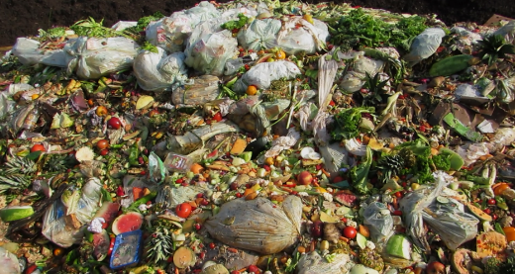
Composting in Brentwood
Why do we care what’s in the landfill?
When food and other organic materials decompose in a landfill where anaerobic (without oxygen) conditions are present, bacteria break down the materials and generate methane, a powerful greenhouse gas.
Municipal solid waste landfills are the third largest source of human-related methane emissions in the U.S, accounting for approximately 14% of methane emissions in 2021.
Wasted food is responsible for 58% of landfill methane emissions.
https://www.epa.gov/sustainable-management-food/composting
Notes:
Major elements of the project include
The Identification and categorization of all resources with flooding/stormwater risk;
Identification of mitigation measures for each category;
Strategies to reduce or eliminate flooding and stormwater as hazards;
Sustainability and climate action goal establishment;
Climate action steps organization and prioritization;
A Sustainability-themed Placemaking Event;
Community engagement and outreach; and
The Final Climate Action Plan and Risk Management Analysis
The proposed project cost is $213,135, and staff recommended releasing funds to undertake the project.

Slide 7
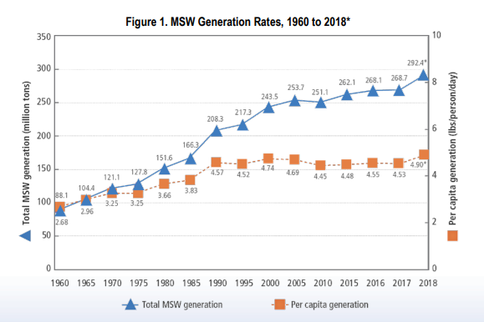
Composting in Brentwood
How does municipal solid waste make our climate worse?
In 2018, in the United States, approximately 292 million tons of municipal solid waste (MSW) were generated. Of the MSW generated, about 94 million tons were recycled or composted, equivalent to a 32.1% recycling and composting rate.
In the U.S., food is the single most common material sent to landfills, comprising 24.1 percent of municipal solid waste. When yard trimmings, wood and paper/paperboard are added to food, these organic materials comprise 51.4 percent of municipal solid waste in landfills.
In 2018, about 94 million tons of MSW in the U.S. were recycled and composted, saving over 193 MMTCO2E (million metric tons of carbon dioxide equivalent). This is comparable to the emissions that could be reduced from taking almost 42 million cars off the road in a year.
https://www.epa.gov/sites/default/files/2021-01/documents/2018_ff_fact_sheet_dec_2020_fnl_508.pdf
Notes:
Major elements of the project include
The Identification and categorization of all resources with flooding/stormwater risk;
Identification of mitigation measures for each category;
Strategies to reduce or eliminate flooding and stormwater as hazards;
Sustainability and climate action goal establishment;
Climate action steps organization and prioritization;
A Sustainability-themed Placemaking Event;
Community engagement and outreach; and
The Final Climate Action Plan and Risk Management Analysis
The proposed project cost is $213,135, and staff recommended releasing funds to undertake the project.

Slide 8
Composting in Brentwood
Why do we compost?
Divert landfill waste
Improves the soil’s ability to retain water, which may assist if the area is prone to flooding or experiences bursts of excessive rainfall
Help absorb greenhouse gas emissions
Rebuild soil health
Conserve water and reduces water use by helping soils retain moisture
Help prevent soil erosion by reducing soil compaction and runoff
Reduce reliance on chemical fertilizers and pesticides
Improve plant growth and promotes higher yields of agricultural crops
Improve water quality by filtering stormwater and reducing nutrient and sediment runoff
Help regenerate poor soil and clean up soils that have been depleted by overuse or contain contaminants
https://www.epa.gov/lmop/basic-information-about-landfill-gas
Notes:
Major elements of the project include
The Identification and categorization of all resources with flooding/stormwater risk;
Identification of mitigation measures for each category;
Strategies to reduce or eliminate flooding and stormwater as hazards;
Sustainability and climate action goal establishment;
Climate action steps organization and prioritization;
A Sustainability-themed Placemaking Event;
Community engagement and outreach; and
The Final Climate Action Plan and Risk Management Analysis
The proposed project cost is $213,135, and staff recommended releasing funds to undertake the project.

Slide 9
Composting in Brentwood
Why do we compost?
Divert landfill waste
Improves the soil’s ability to retain water, which may assist if the area is prone to flooding or experiences bursts of excessive rainfall
Help absorb greenhouse gas emissions
Rebuild soil health
Conserve water and reduces water use by helping soils retain moisture
Help prevent soil erosion by reducing soil compaction and runoff
Reduce reliance on chemical fertilizers and pesticides
Improve plant growth and promotes higher yields of agricultural crops
Improve water quality by filtering stormwater and reducing nutrient and sediment runoff
Help regenerate poor soil and clean up soils that have been depleted by overuse or contain contaminants
https://www.epa.gov/lmop/basic-information-about-landfill-gas
Notes:
Major elements of the project include
The Identification and categorization of all resources with flooding/stormwater risk;
Identification of mitigation measures for each category;
Strategies to reduce or eliminate flooding and stormwater as hazards;
Sustainability and climate action goal establishment;
Climate action steps organization and prioritization;
A Sustainability-themed Placemaking Event;
Community engagement and outreach; and
The Final Climate Action Plan and Risk Management Analysis
The proposed project cost is $213,135, and staff recommended releasing funds to undertake the project.

Slide 10
Tree Committee 2024 Plan
Due Date | Activity | Lead
January 27, 10AM | Ivy removal from trees | Nigel
February | Info package on care and maintenance guidance for residents | Lauren
March | Tree health update walk and identification of replacement, pruning, removal, new planting - includes Rhode Island Avenue | Savannah
April Last Friday of the month | Arbor Day event Include possible tree replacement | Gary, Savannah
June | Town code, care, practices – research | Jason/Jacob/Lauren
Placemaking event | Community Survey | Sara
November | Seed collection day for kids | Gary
 | Grants – identify best fit, timeline, recommend application | TBD
 | Tree maintenance workshop, include right tree, right place guidance | in partnership with MD DNR
Get involved with the Tree Committee – contact cm3@brentwoodmd.gov
Notes:
Major elements of the project include
The Identification and categorization of all resources with flooding/stormwater risk;
Identification of mitigation measures for each category;
Strategies to reduce or eliminate flooding and stormwater as hazards;
Sustainability and climate action goal establishment;
Climate action steps organization and prioritization;
A Sustainability-themed Placemaking Event;
Community engagement and outreach; and
The Final Climate Action Plan and Risk Management Analysis
The proposed project cost is $213,135, and staff recommended releasing funds to undertake the project.

Slide 11
Brentwood Native Plant Network 2024 Plan
Due Date | Activity | Lead
January | Info table at Wellness Event at Mixt | Scott
May | Spring Plant Swap | TBD
May | Spring Yard Certification | Scott
June | Info table at Brentwood Day | TBD
Placemaking event | TBD | TBD
November | Winter Sowing and Seed Swap Event | Emily
TBD | Native Plant Mapping | Gary/Scott
Spring-Fall | Public Park Maintenance | Emily
Get involved with the Brentwood Native Plant Network – contact cm3@brentwoodmd.gov
Notes:
Major elements of the project include
The Identification and categorization of all resources with flooding/stormwater risk;
Identification of mitigation measures for each category;
Strategies to reduce or eliminate flooding and stormwater as hazards;
Sustainability and climate action goal establishment;
Climate action steps organization and prioritization;
A Sustainability-themed Placemaking Event;
Community engagement and outreach; and
The Final Climate Action Plan and Risk Management Analysis
The proposed project cost is $213,135, and staff recommended releasing funds to undertake the project.

Slide 12
Green Team 2024 Plan
Due Date | Activity | Lead
February | Green Team training with Sustainable Maryland
March | Online Environmental Resource Center | Lauren
April | Begin Composting Campaign | Scott & Aliza
Spring-Summer | Better Bag Bill education and outreach
May – October | Northwest Branch of Anacostia river water quality testing
June | Info tables at Brentwood Day
July 1 | Apply for a FY25 Maryland Heritage Area – Anacostia Trails Heritage Area grant to improve the Northwest Branch Trail in cooperation with MNCPPC, Gateway Arts District
Placemaking event | CBT Community Engagement and Restoration Mini Grant storm drain stenciling
October | Stream Valley Park assessment and plan with Prince George’s County Parks Dept
November | Safe Grow Act to reduce pesticide use
All year | Support Safe Streets for All through Vision Zero committee work
Get involved with the Green Team – contact cm3@brentwoodmd.gov
Notes:
Major elements of the project include
The Identification and categorization of all resources with flooding/stormwater risk;
Identification of mitigation measures for each category;
Strategies to reduce or eliminate flooding and stormwater as hazards;
Sustainability and climate action goal establishment;
Climate action steps organization and prioritization;
A Sustainability-themed Placemaking Event;
Community engagement and outreach; and
The Final Climate Action Plan and Risk Management Analysis
The proposed project cost is $213,135, and staff recommended releasing funds to undertake the project.

Slide 13

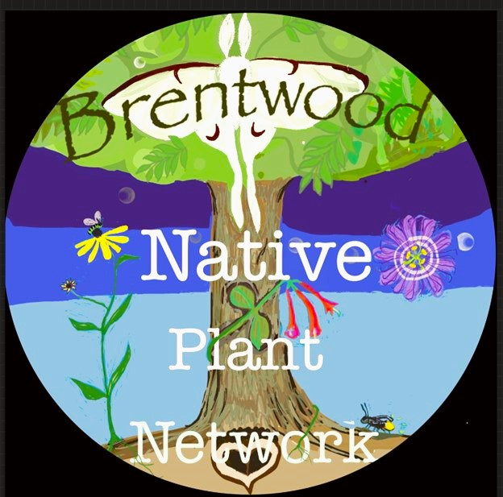
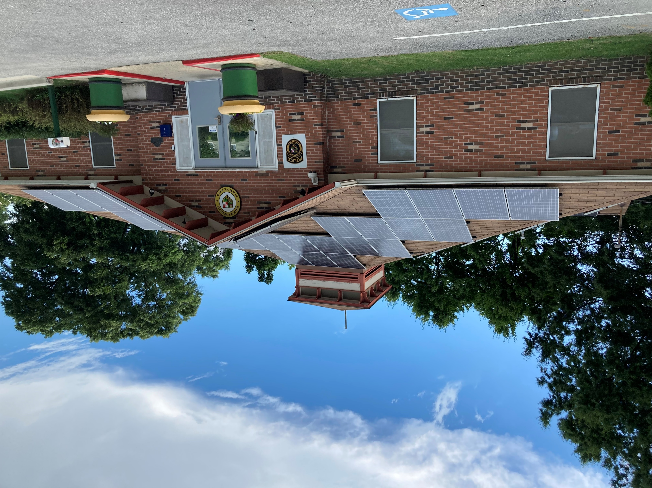

Autumn Updates
Tree Committee lead Nigel Dawson took the invasive ivy removal training from Hyattsville
Tree Committee met with Maryland Department of Natural Resources to discuss Maryland Forest Service’s 5 Million Trees initiative. Opportunities:
Statewide goal to plant 5 million native trees by 2031 and 10% in underserved communities
Planning, Coordination, and Technical Assistance related to…
Tree plantings & maintenance
Grant Administration
Forest management
Seed collection
Expanding volunteer opportunities
Outreach & community engagement
Green Team
River clean-up with Friends of the Northwest Branch with video
Renewable Energy
“Sustainable Brentwood Online Resources” document in progress
Notes:
Major elements of the project include
The Identification and categorization of all resources with flooding/stormwater risk;
Identification of mitigation measures for each category;
Strategies to reduce or eliminate flooding and stormwater as hazards;
Sustainability and climate action goal establishment;
Climate action steps organization and prioritization;
A Sustainability-themed Placemaking Event;
Community engagement and outreach; and
The Final Climate Action Plan and Risk Management Analysis
The proposed project cost is $213,135, and staff recommended releasing funds to undertake the project.

Slide 14
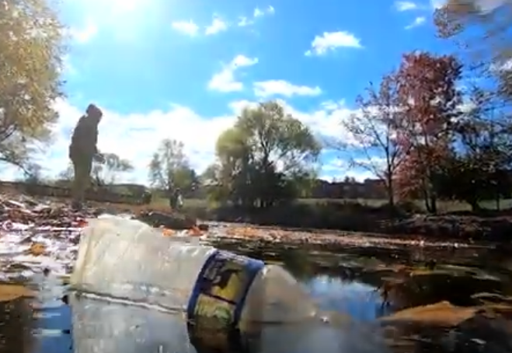
Town videographer, Matt Carl created a short film about the Green Team and the river clean-up event with Friends of the Northwest Branch
Check it out on the Brentwood YouTube page
https://www.youtube.com/watch?v=gUr2DQyVEPY
Notes:
Major elements of the project include
The Identification and categorization of all resources with flooding/stormwater risk;
Identification of mitigation measures for each category;
Strategies to reduce or eliminate flooding and stormwater as hazards;
Sustainability and climate action goal establishment;
Climate action steps organization and prioritization;
A Sustainability-themed Placemaking Event;
Community engagement and outreach; and
The Final Climate Action Plan and Risk Management Analysis
The proposed project cost is $213,135, and staff recommended releasing funds to undertake the project.

Slide 15




Notes:
Major elements of the project include
The Identification and categorization of all resources with flooding/stormwater risk;
Identification of mitigation measures for each category;
Strategies to reduce or eliminate flooding and stormwater as hazards;
Sustainability and climate action goal establishment;
Climate action steps organization and prioritization;
A Sustainability-themed Placemaking Event;
Community engagement and outreach; and
The Final Climate Action Plan and Risk Management Analysis
The proposed project cost is $213,135, and staff recommended releasing funds to undertake the project.

Slide 16
Upcoming events
Saturday, January 13 10AM Brentwood Native Plant Network at town hall
Saturday, January 13 11AM Sustainable Brentwood meeting at town hall
Saturday, January 27 Tree Committee ivy removal from trees and tree health identification walk – meet at the Public Works Department
TENTATIVE Saturday, February 10 Training with Sustainable Maryland
Notes:
Major elements of the project include
The Identification and categorization of all resources with flooding/stormwater risk;
Identification of mitigation measures for each category;
Strategies to reduce or eliminate flooding and stormwater as hazards;
Sustainability and climate action goal establishment;
Climate action steps organization and prioritization;
A Sustainability-themed Placemaking Event;
Community engagement and outreach; and
The Final Climate Action Plan and Risk Management Analysis
The proposed project cost is $213,135, and staff recommended releasing funds to undertake the project.

Slide 17
Councilmember October – December recap
Collaborated with Neighborhood Design Center, Ecosite, Town of North Brentwood and Councilmember Monroe on the Prince George’s County Stormwater Grant for Windom Road Historical Barrier Park
Chesapeake Bay Trust consult on grant
Fall Maryland Municipal League in October, courses attended:
College Park sustainability walk with municipal leaders
Supporting an Energy Efficient Community with Maryland Energy Administration & Department of Housing and Community Development
Traffic Calming, Road Diets, and Speed Management: Moving to Pedestrian Safety with The Traffic Group
Municipal Budgeting
Joint Emergency Management Officials Department meet & greet
Effective Meetings
Ethics
Prince George’s County Municipal Association
US Army Corps of Engineers Anacostia Watershed Restoration Project Stakeholder Update
Joined the Emergency Management Officials Department, attended November meeting
Met with City of Annapolis and provided Town staff with approaches for helping residents in need
D47 Leaders Meeting with Senator Augustine
Meeting with Maryland-National Capital Park and Planning Commission – Department of Parks and Recreation, Prince George’s County – Park Planning Section, Land Management and Environmental Stewardship Division re: Stream Valley Park
Notes:
Major elements of the project include
The Identification and categorization of all resources with flooding/stormwater risk;
Identification of mitigation measures for each category;
Strategies to reduce or eliminate flooding and stormwater as hazards;
Sustainability and climate action goal establishment;
Climate action steps organization and prioritization;
A Sustainability-themed Placemaking Event;
Community engagement and outreach; and
The Final Climate Action Plan and Risk Management Analysis
The proposed project cost is $213,135, and staff recommended releasing funds to undertake the project.

Slide 18
Councilmember October – December recap
Sustainable Maryland and Sierra Club – Better Bag Bill / Plastic Bag Ban webinar
River litter clean-up with Friends of Northwest
Meeting with Town Administrator and Green Team on town composting options
Attended Congressman Ivey’s Community Project Funding webinar
2023 Annual PGCMA Legislative Meet & Greet
District 2 Community Conversations with County Councilwoman Fisher and Senator Augustine, DPIE, Family Services, Parking
Presented comments to the Prince George’s County Planning Board on the MNCPPC PAMC
Meeting with SolSmart on solar permitting resources for residents
Meeting with UMD School of Public Policy for a spring internship
Had to drop from the National League of Cities & Local Infrastructure Hub – Climate Action “Bootcamp” due to scheduling conflicts. Gateway CDC, Mt Rainier, Brentwood, North Brentwood considering EPA grant.
Notes:
Major elements of the project include
The Identification and categorization of all resources with flooding/stormwater risk;
Identification of mitigation measures for each category;
Strategies to reduce or eliminate flooding and stormwater as hazards;
Sustainability and climate action goal establishment;
Climate action steps organization and prioritization;
A Sustainability-themed Placemaking Event;
Community engagement and outreach; and
The Final Climate Action Plan and Risk Management Analysis
The proposed project cost is $213,135, and staff recommended releasing funds to undertake the project.

